Slide 1

EasyWay
Sprint 7
Subject: CS692
Computer Science Project 2
Designed By:
Vidisha Vijay Sawant

Slide 2

Agenda

Slide 3
Agenda
Team members roles and responsibilities
Improvements made from professor feedback
Project description
Team working agreement
Personas
MVP
Technologies
Algorithm
Diagrams
Sprint 6 Recap
Product Backlog
Sprint 7 Backlog
Metrics
Retrospective
Sprint 8
Project Demo
Github link
Live application Demo

Slide 4


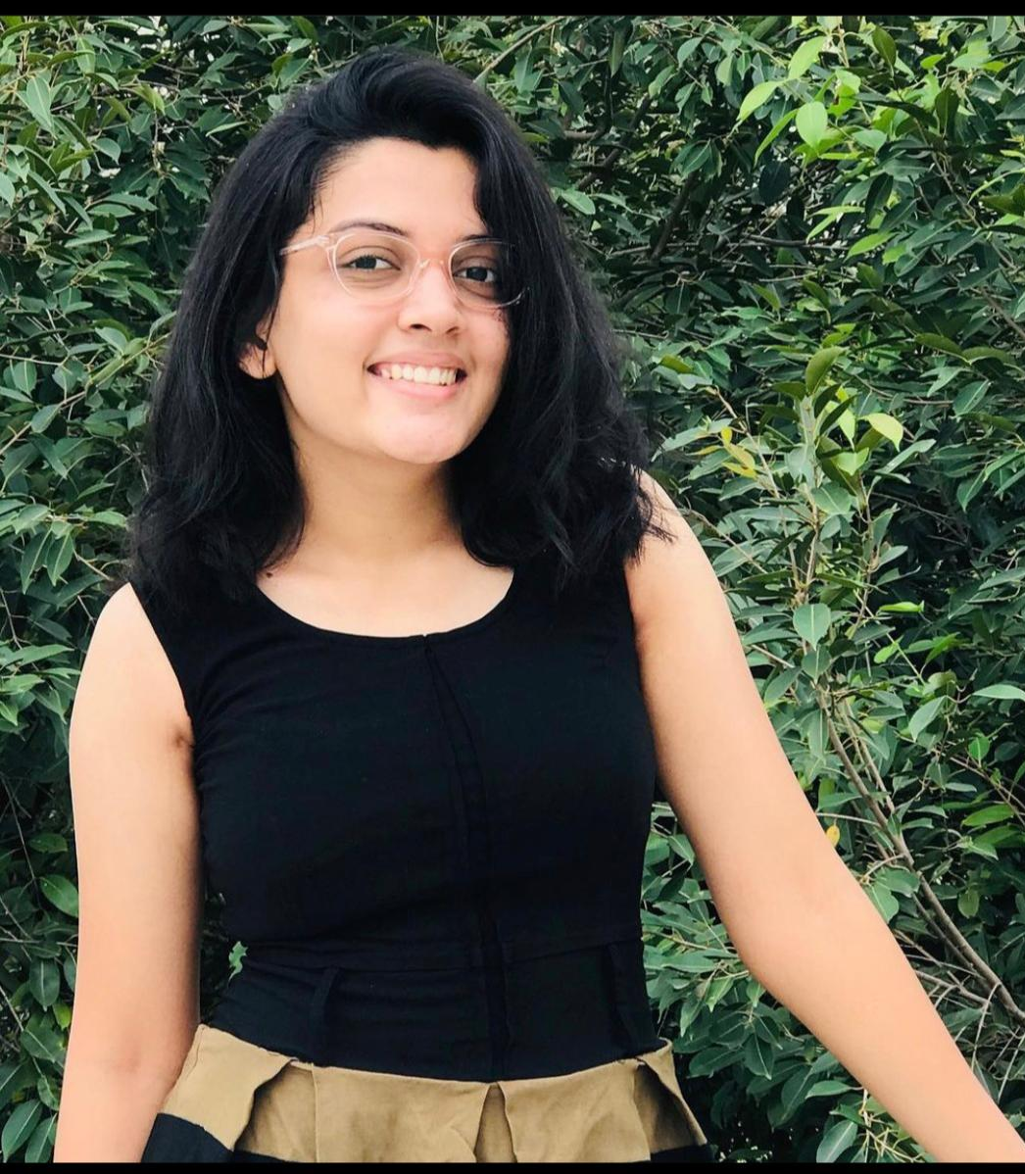
Team Member Roles
Vidisha Vijay Sawant
Developer
Kshitij Sharma
Developer
Femina Baldha
Developer

Slide 5



Team Member Roles
Aditya Kadarla
Project Manager
Quality Analyst & Tester
Shubham Sawant
Business Analyst & Developer
Ravi Kumar Dabbada
Database Administrator

Slide 6
Improvements made from Professor Feedback
No Feedback

Slide 7
Project Description
Project Description
Project Name: | EasyWay
Team Name: | D-Coders
Project Description: | Get instant access to reliable, certified, and affordable on-demand home services. For customers who want to book on-demand home services, the EasyWay is a web app that provides a hassle-less booking of a home service, unlike the traditional way where we had to call or text and ask for any professional's availability our solution provides the availability of any professional online with booking service.
Benefit Outcomes: | Users can book services according to their preferred date and time. Users can see the services categories and can click on them to see the booking screen.
GitHub Wiki: | https://github.com/ksharma67/EasyWay/wiki

Slide 8
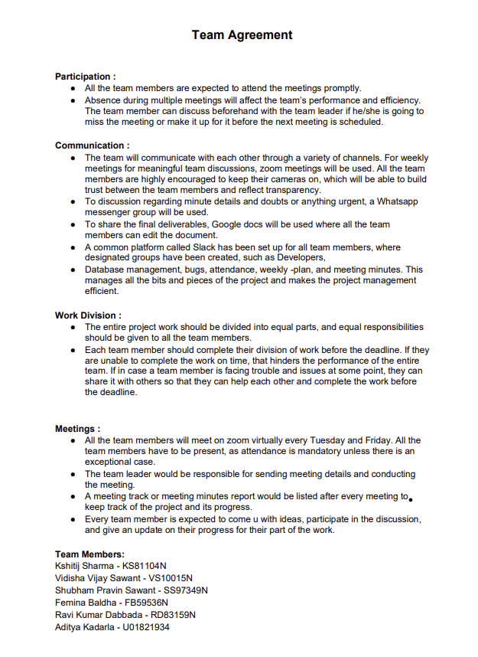
Team Working Agreement

Slide 9

Personas

Slide 10
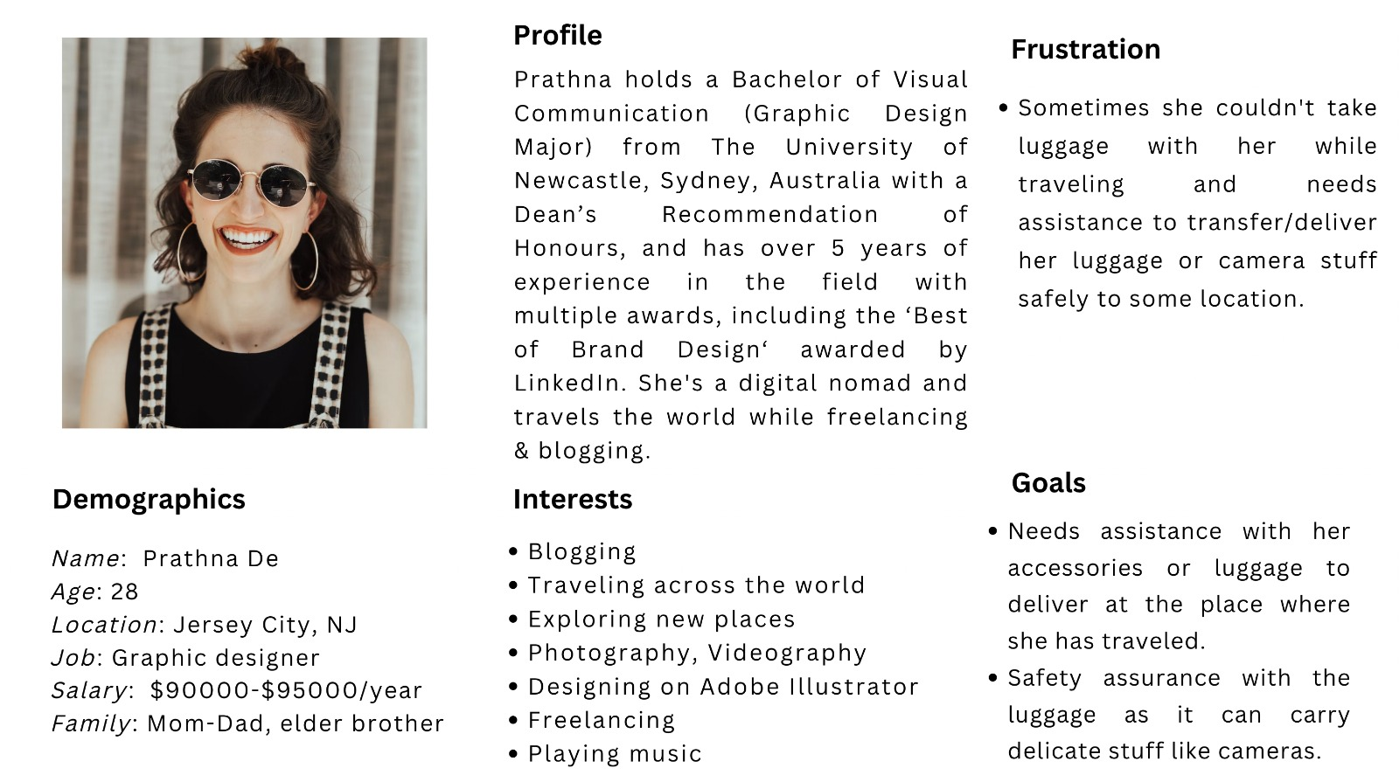
Persona 1

Slide 11
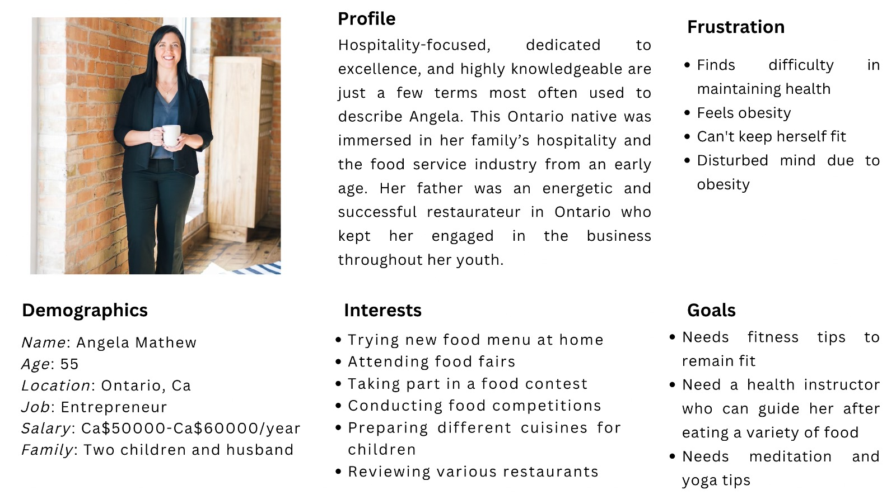
Persona 2

Slide 12
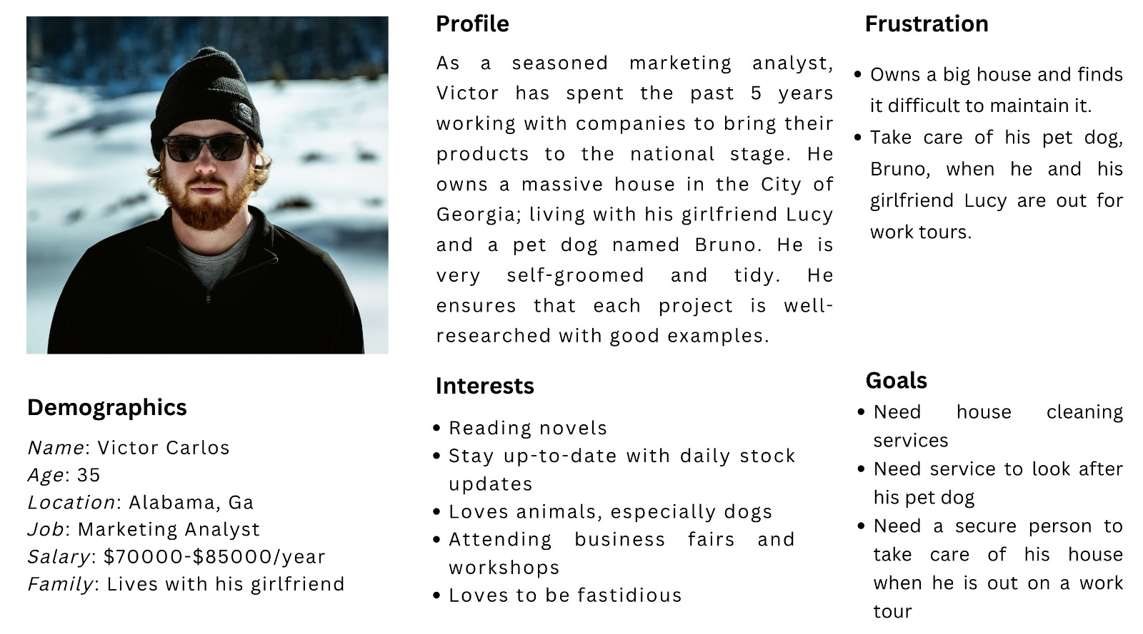
Persona 3

Slide 13



Minimal Viable Product (MVP)
Homepage
Service Catalog
Cancel Booking
Registration – Customer and Professional
Login – Customer and Professional
Book – Calendar and Time
Booking Confirmation via email or in-app

Slide 14
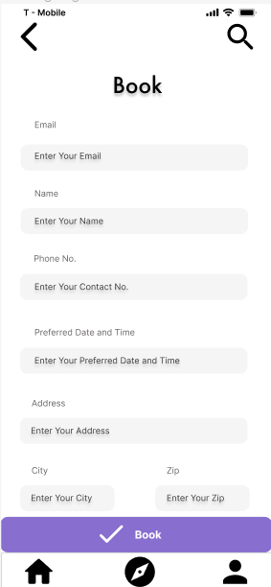
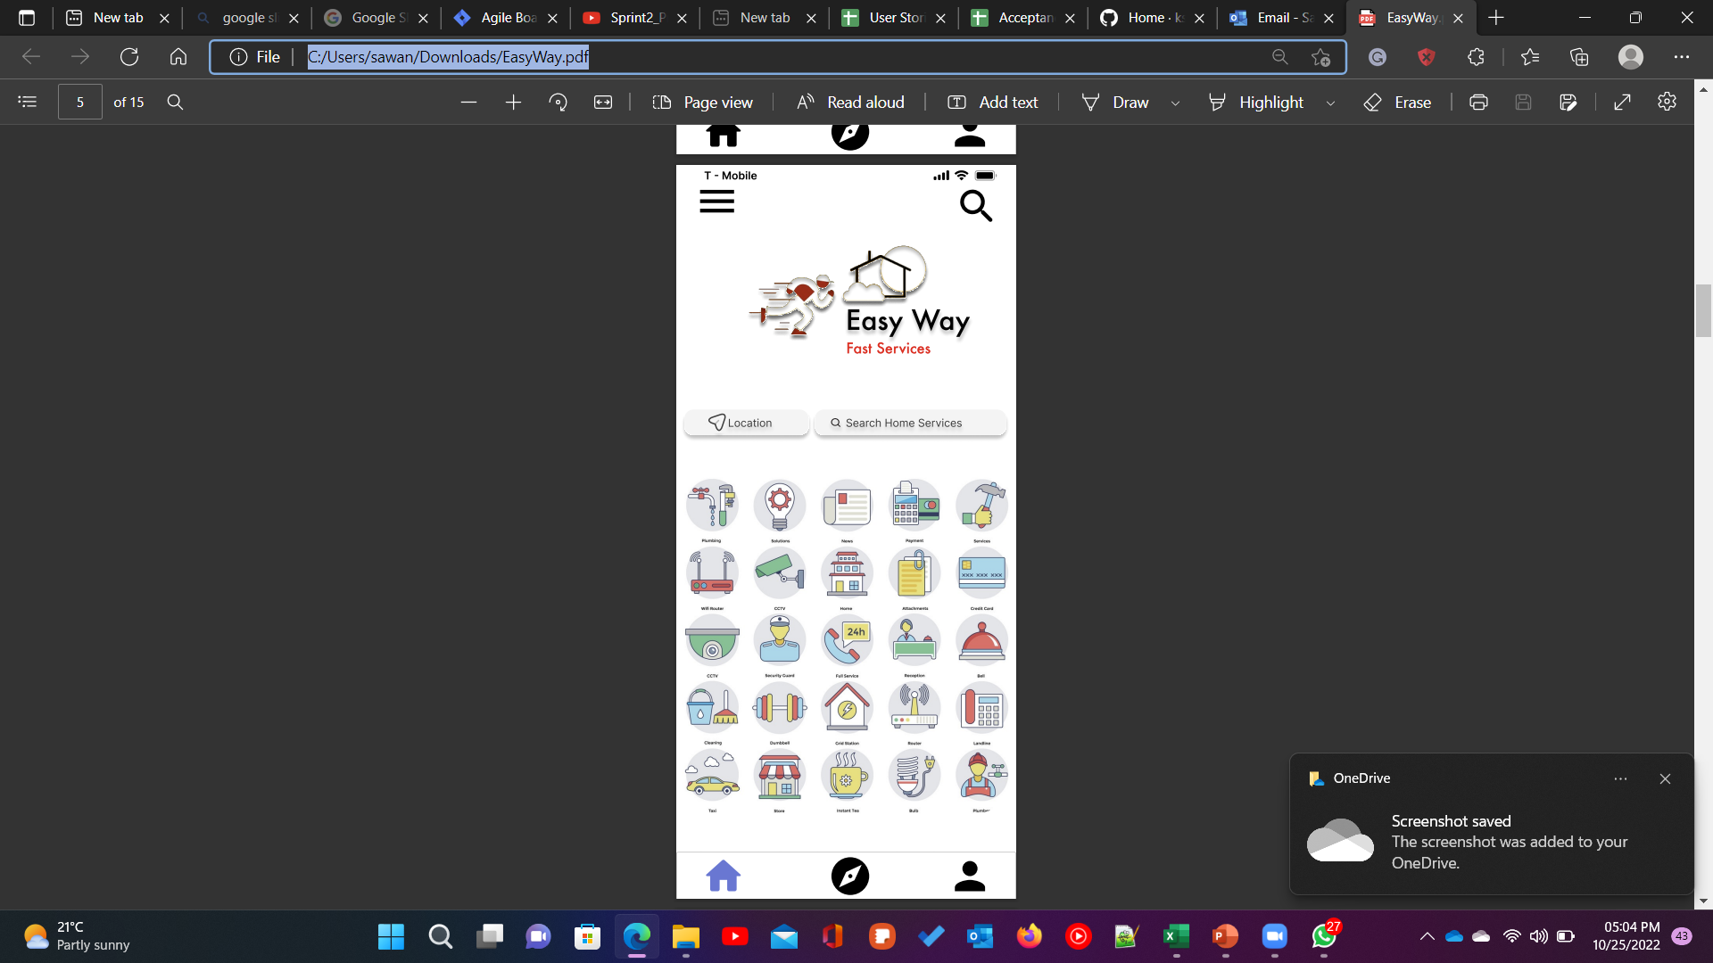
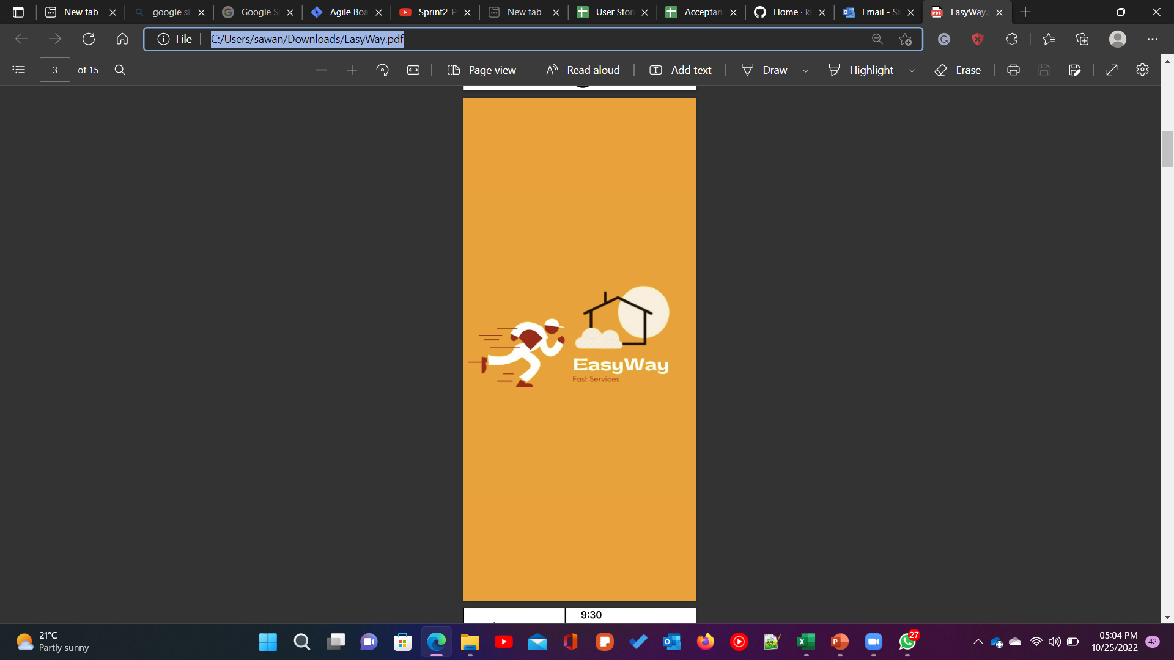
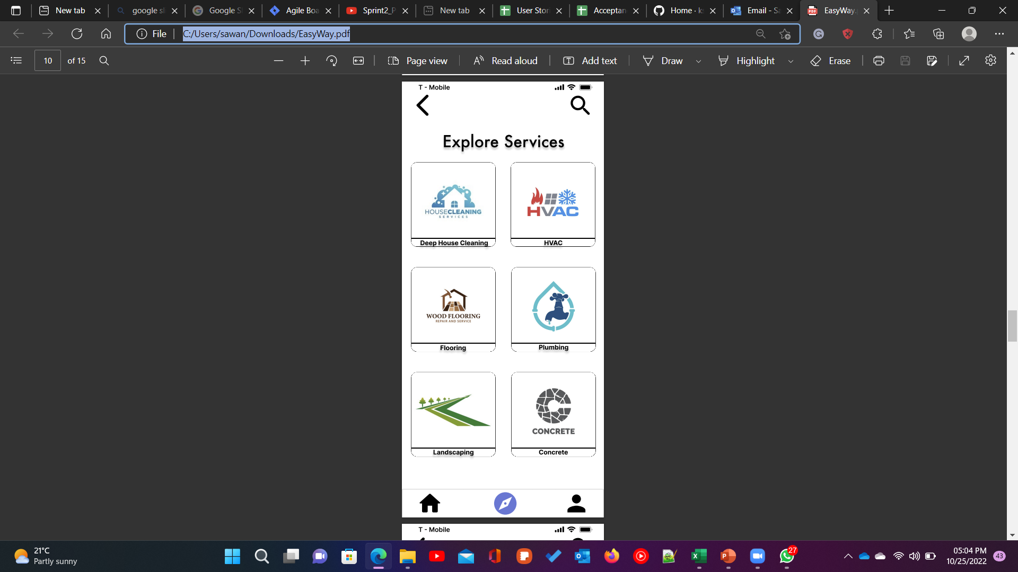
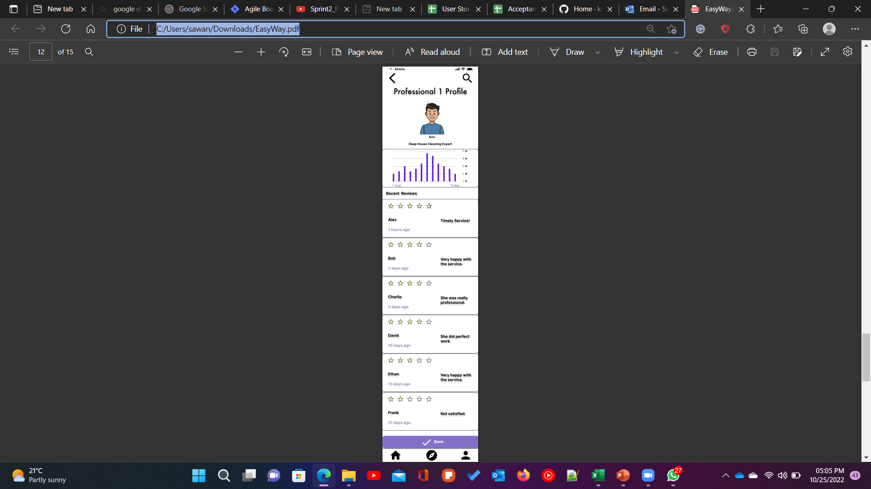
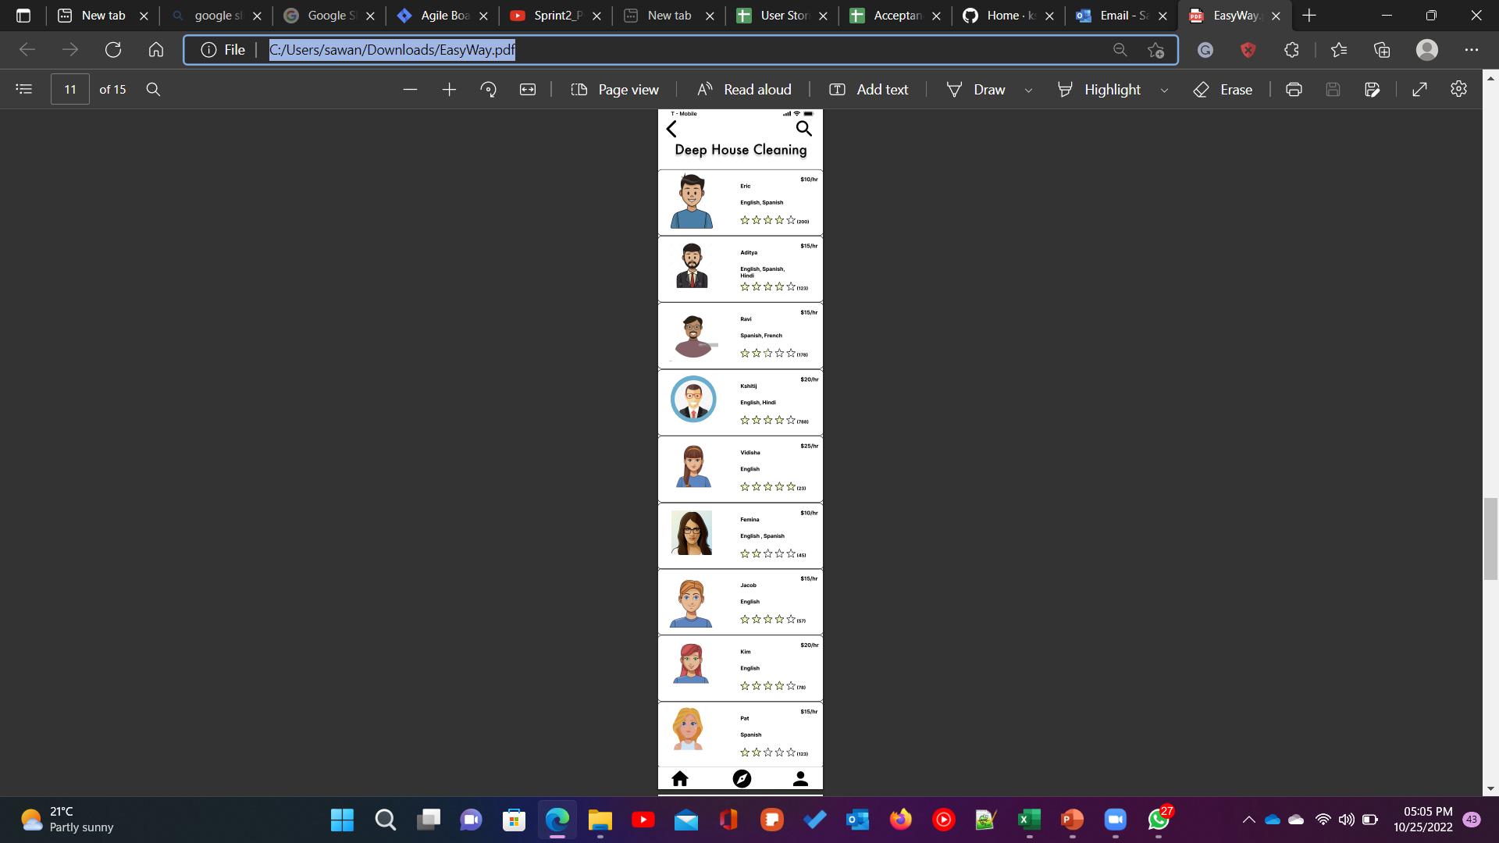
Minimal Viable Product (MVP)

Slide 15
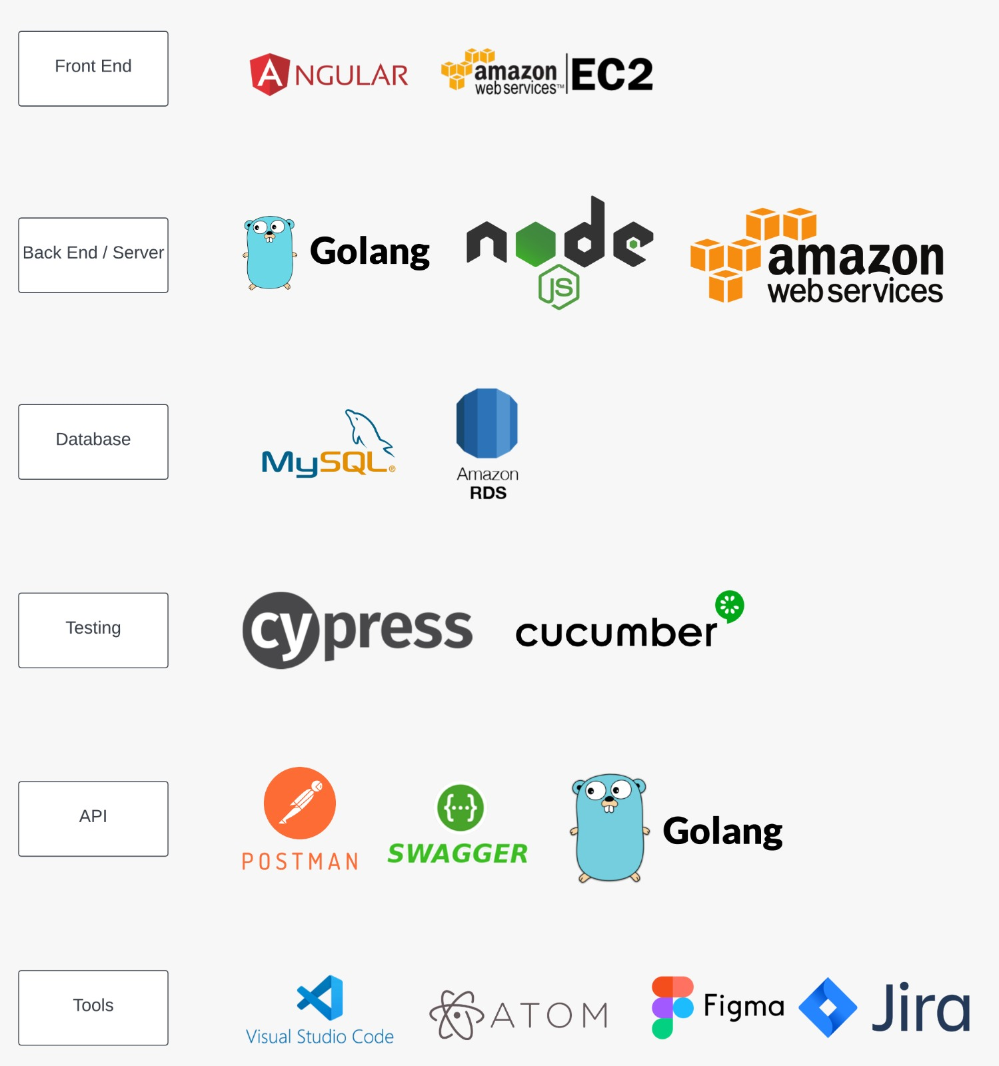
Technologies

Slide 16
Algorithms
This is a real-time object detection algorithm that identifies specific objects in videos, live feeds, or images. This machine learning algorithm uses features learned by a deep convolutional neural network to detect an object. Object classification systems are used by Artificial Intelligence (AI) programs to perceive specific objects in a class as subjects of interest. The systems sort objects in images into groups where objects with similar characteristics are placed together, while others are neglected unless programmed to do otherwise. This is a Convolutional Neural Network (CNN) for performing object detection in real-time. CNNs are classifier-based systems that can process input images as structured arrays of data and recognize patterns between them (view the image on the next slide). This has the advantage of being much faster than other networks and still maintains accuracy. It allows the model to look at the whole image at test time, so its predictions are informed by the global context in the image. All other convolutional neural network algorithms “score” regions based on their similarities to predefined classes. High-scoring regions are noted as positive detections of whatever class they most closely identify with.

Slide 17
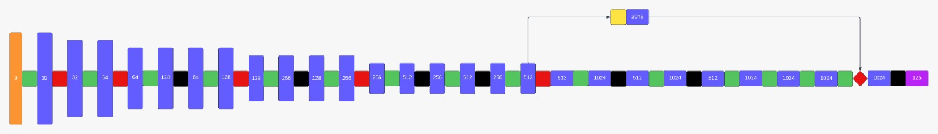
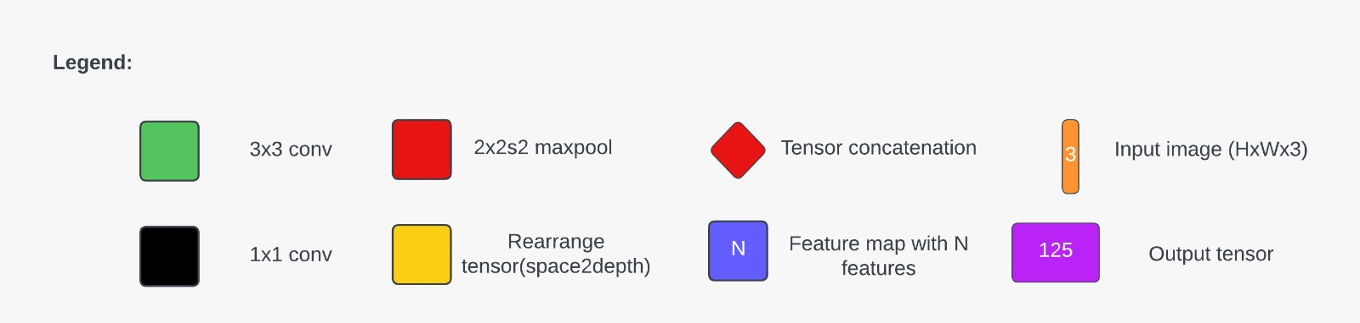
Algorithms

Slide 18

Diagrams

Slide 19
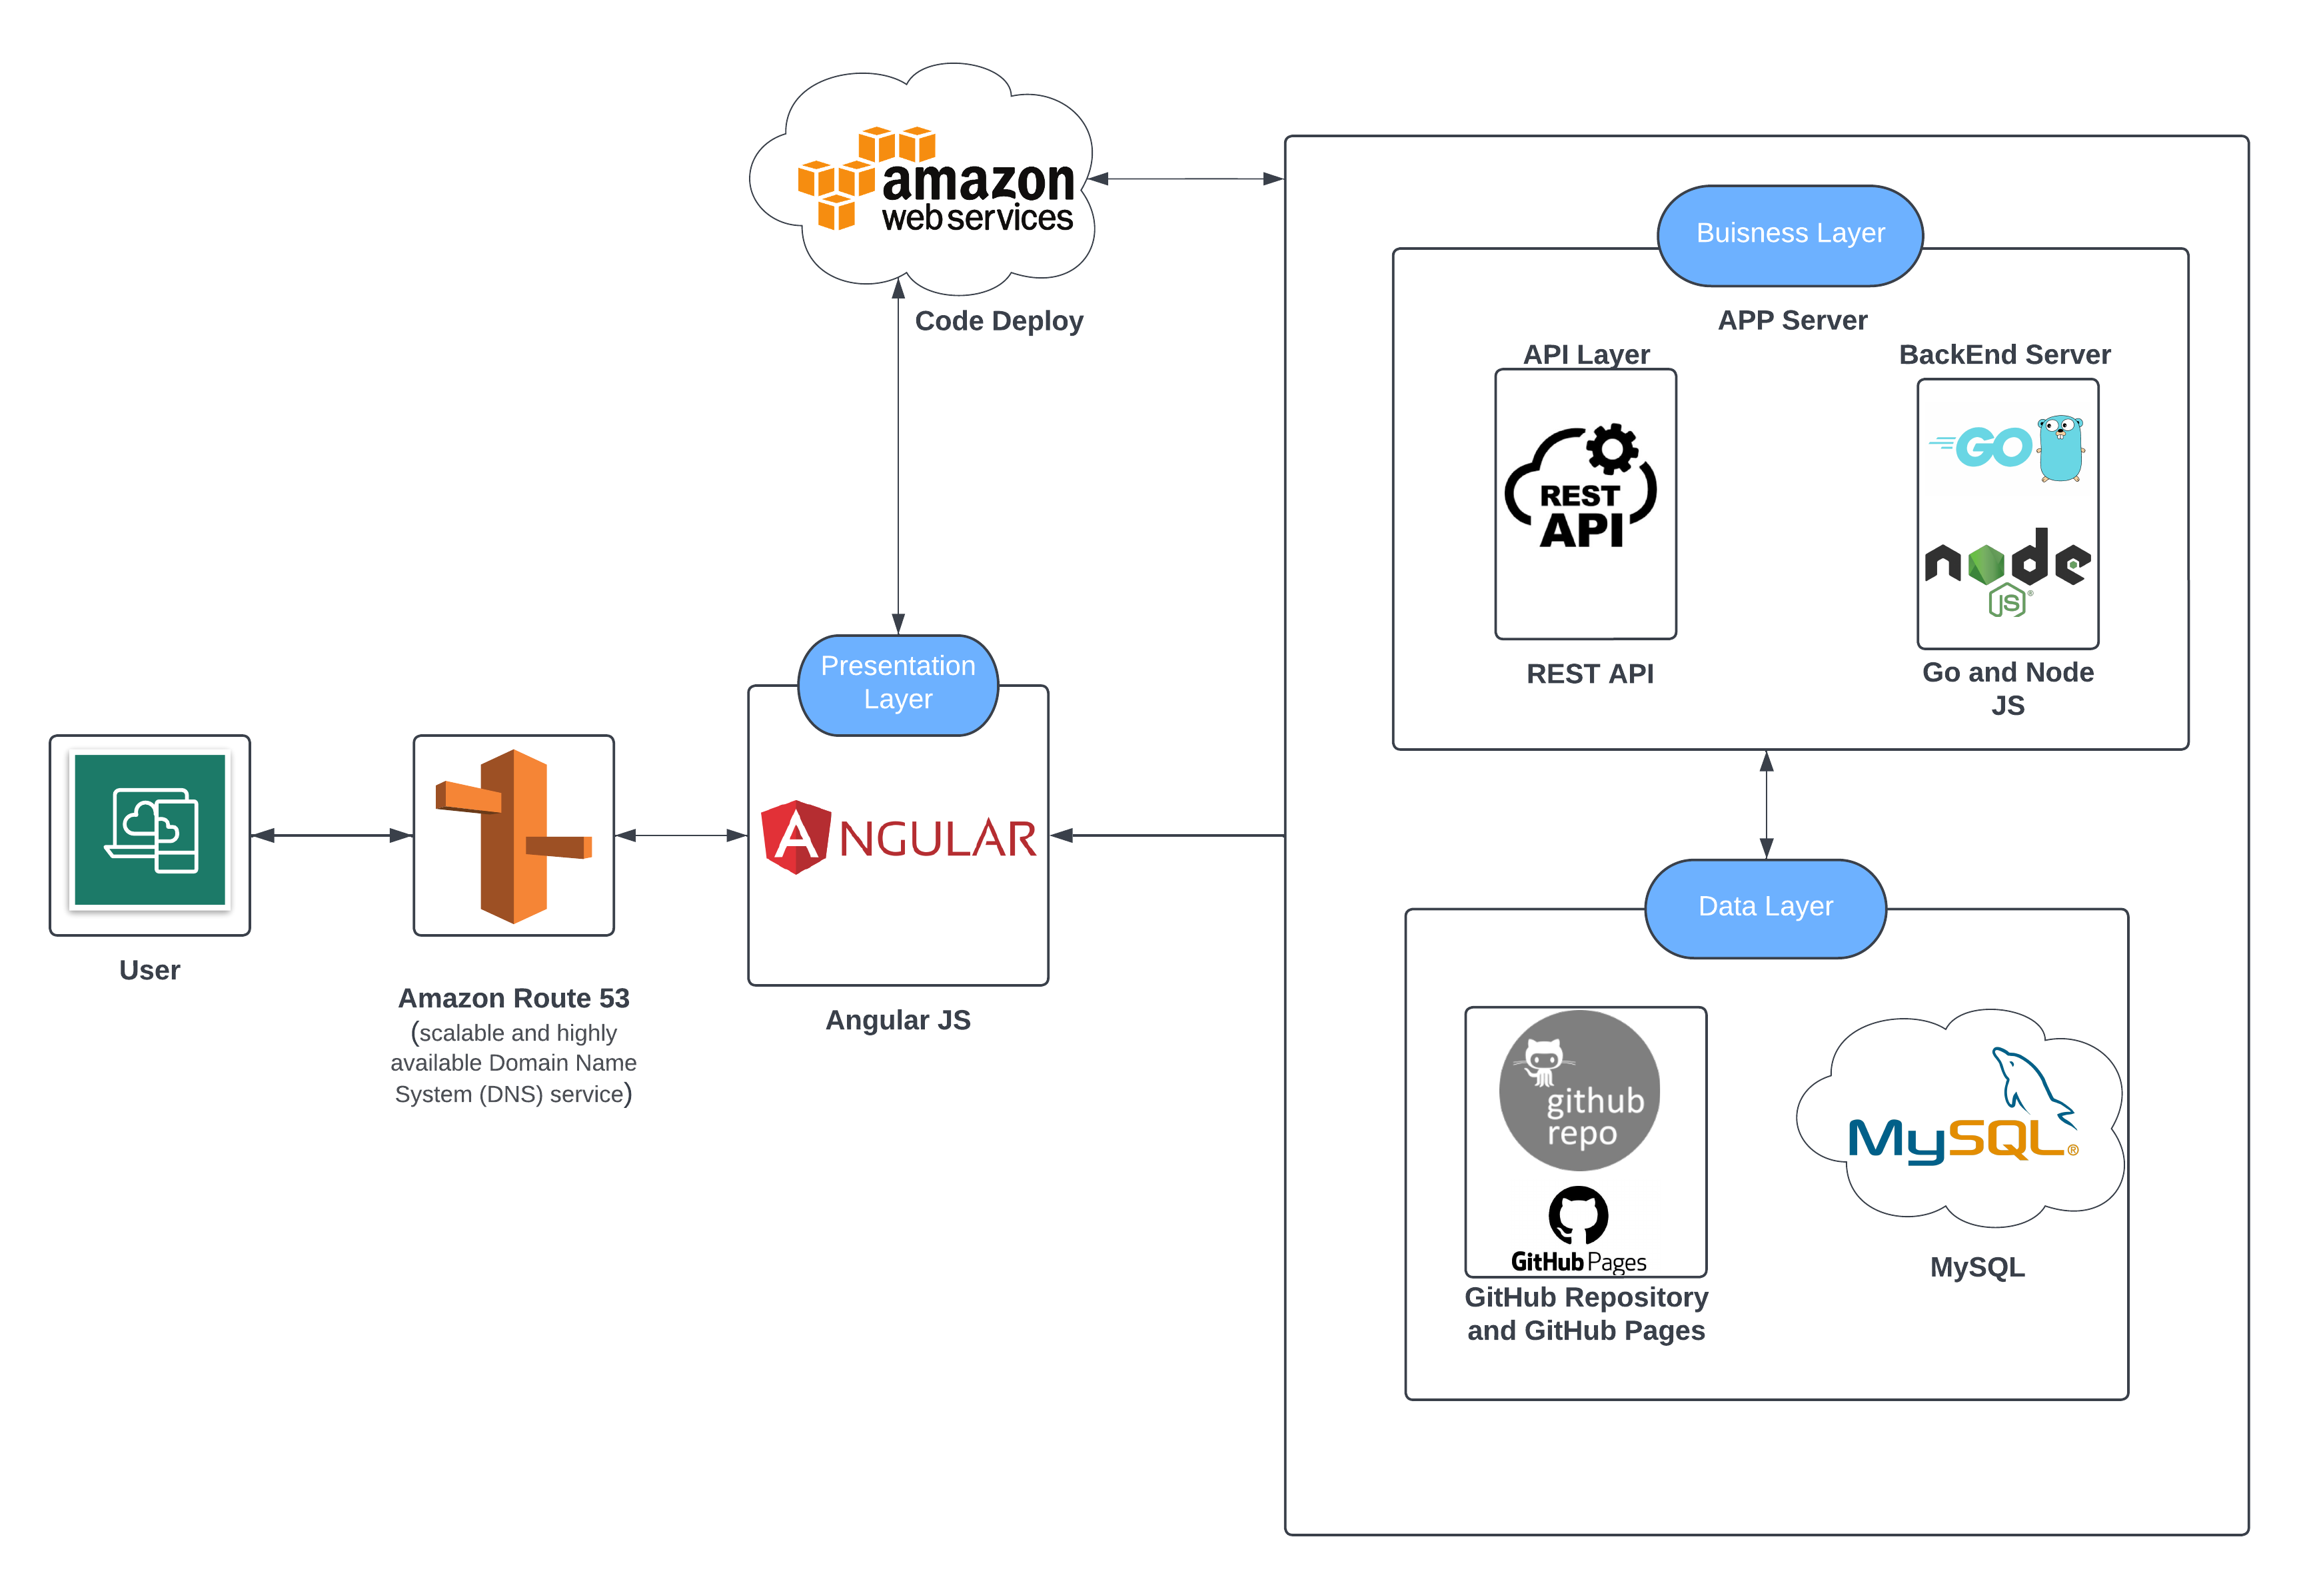
Conceptual Architecture Diagram

Slide 20
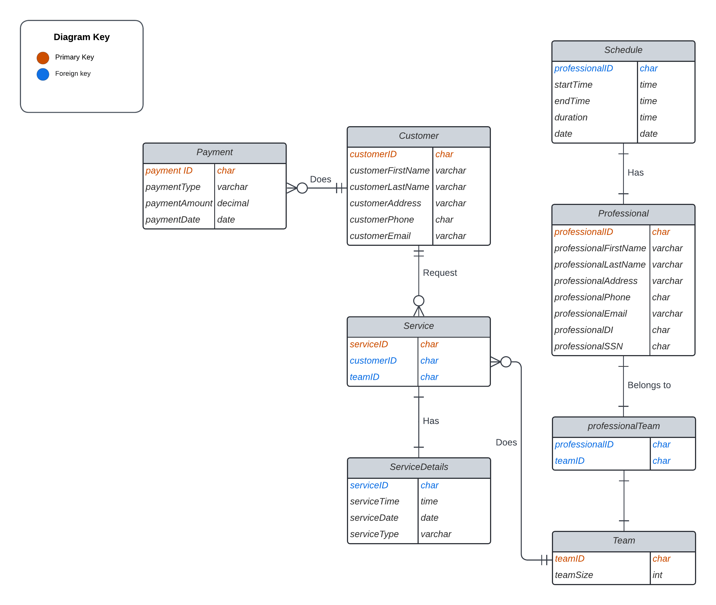
ERD Diagram

Slide 21
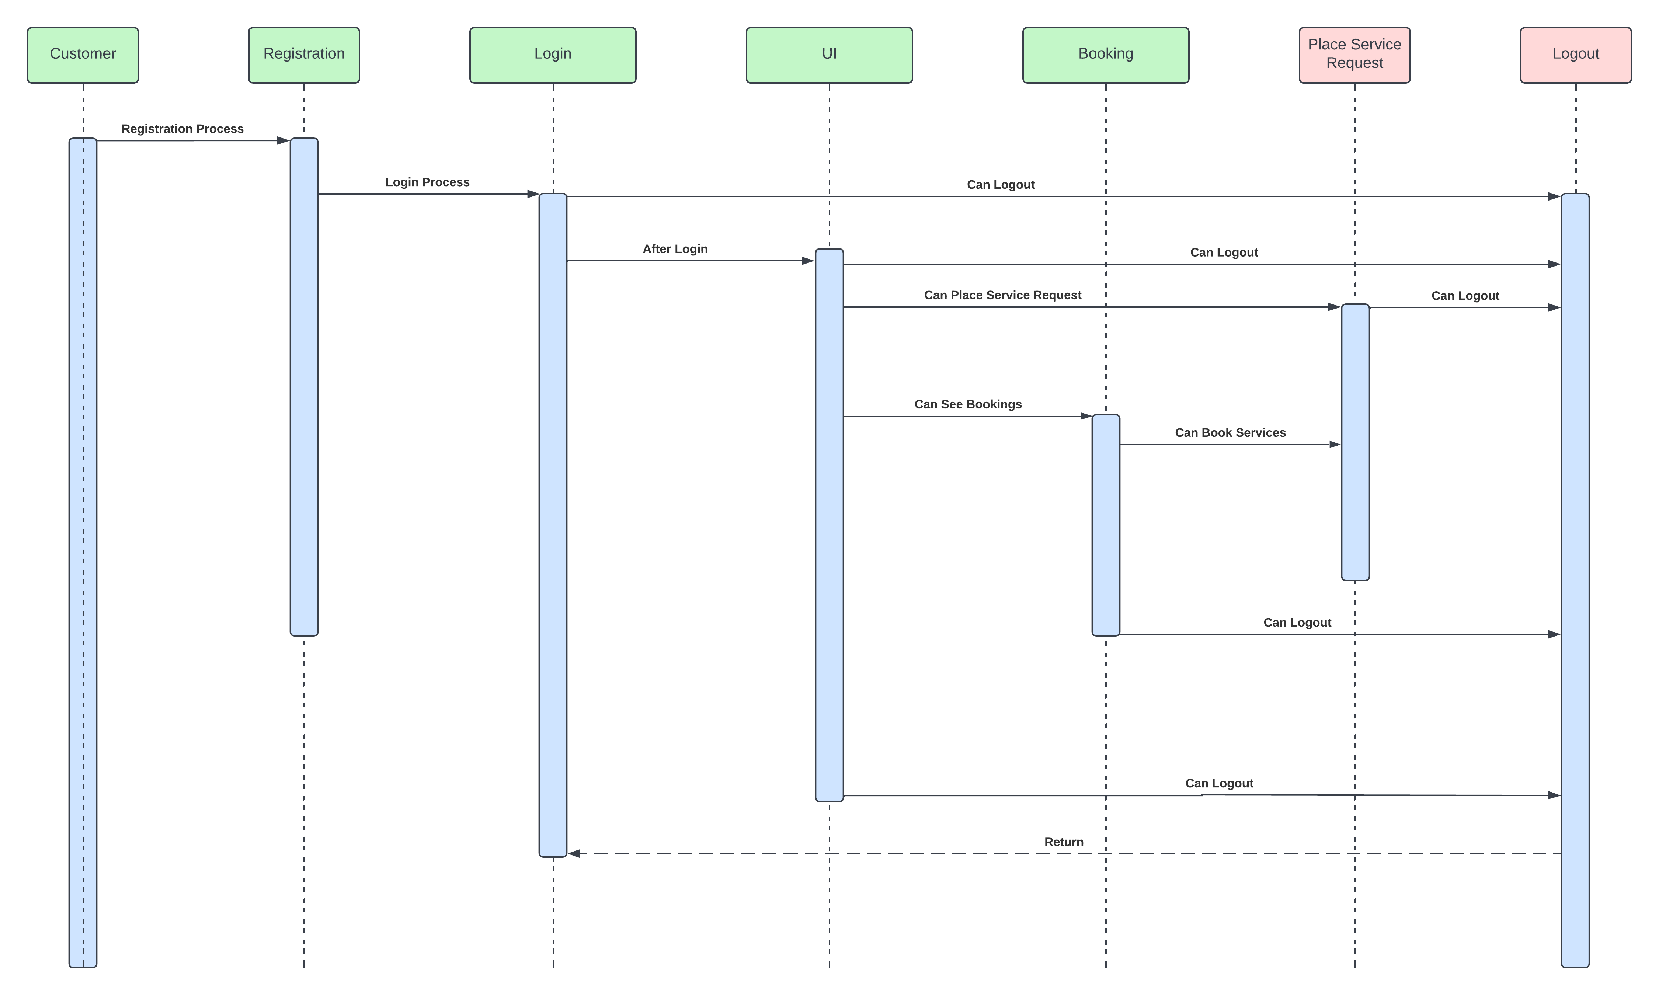
User Sequence Diagram

Slide 22
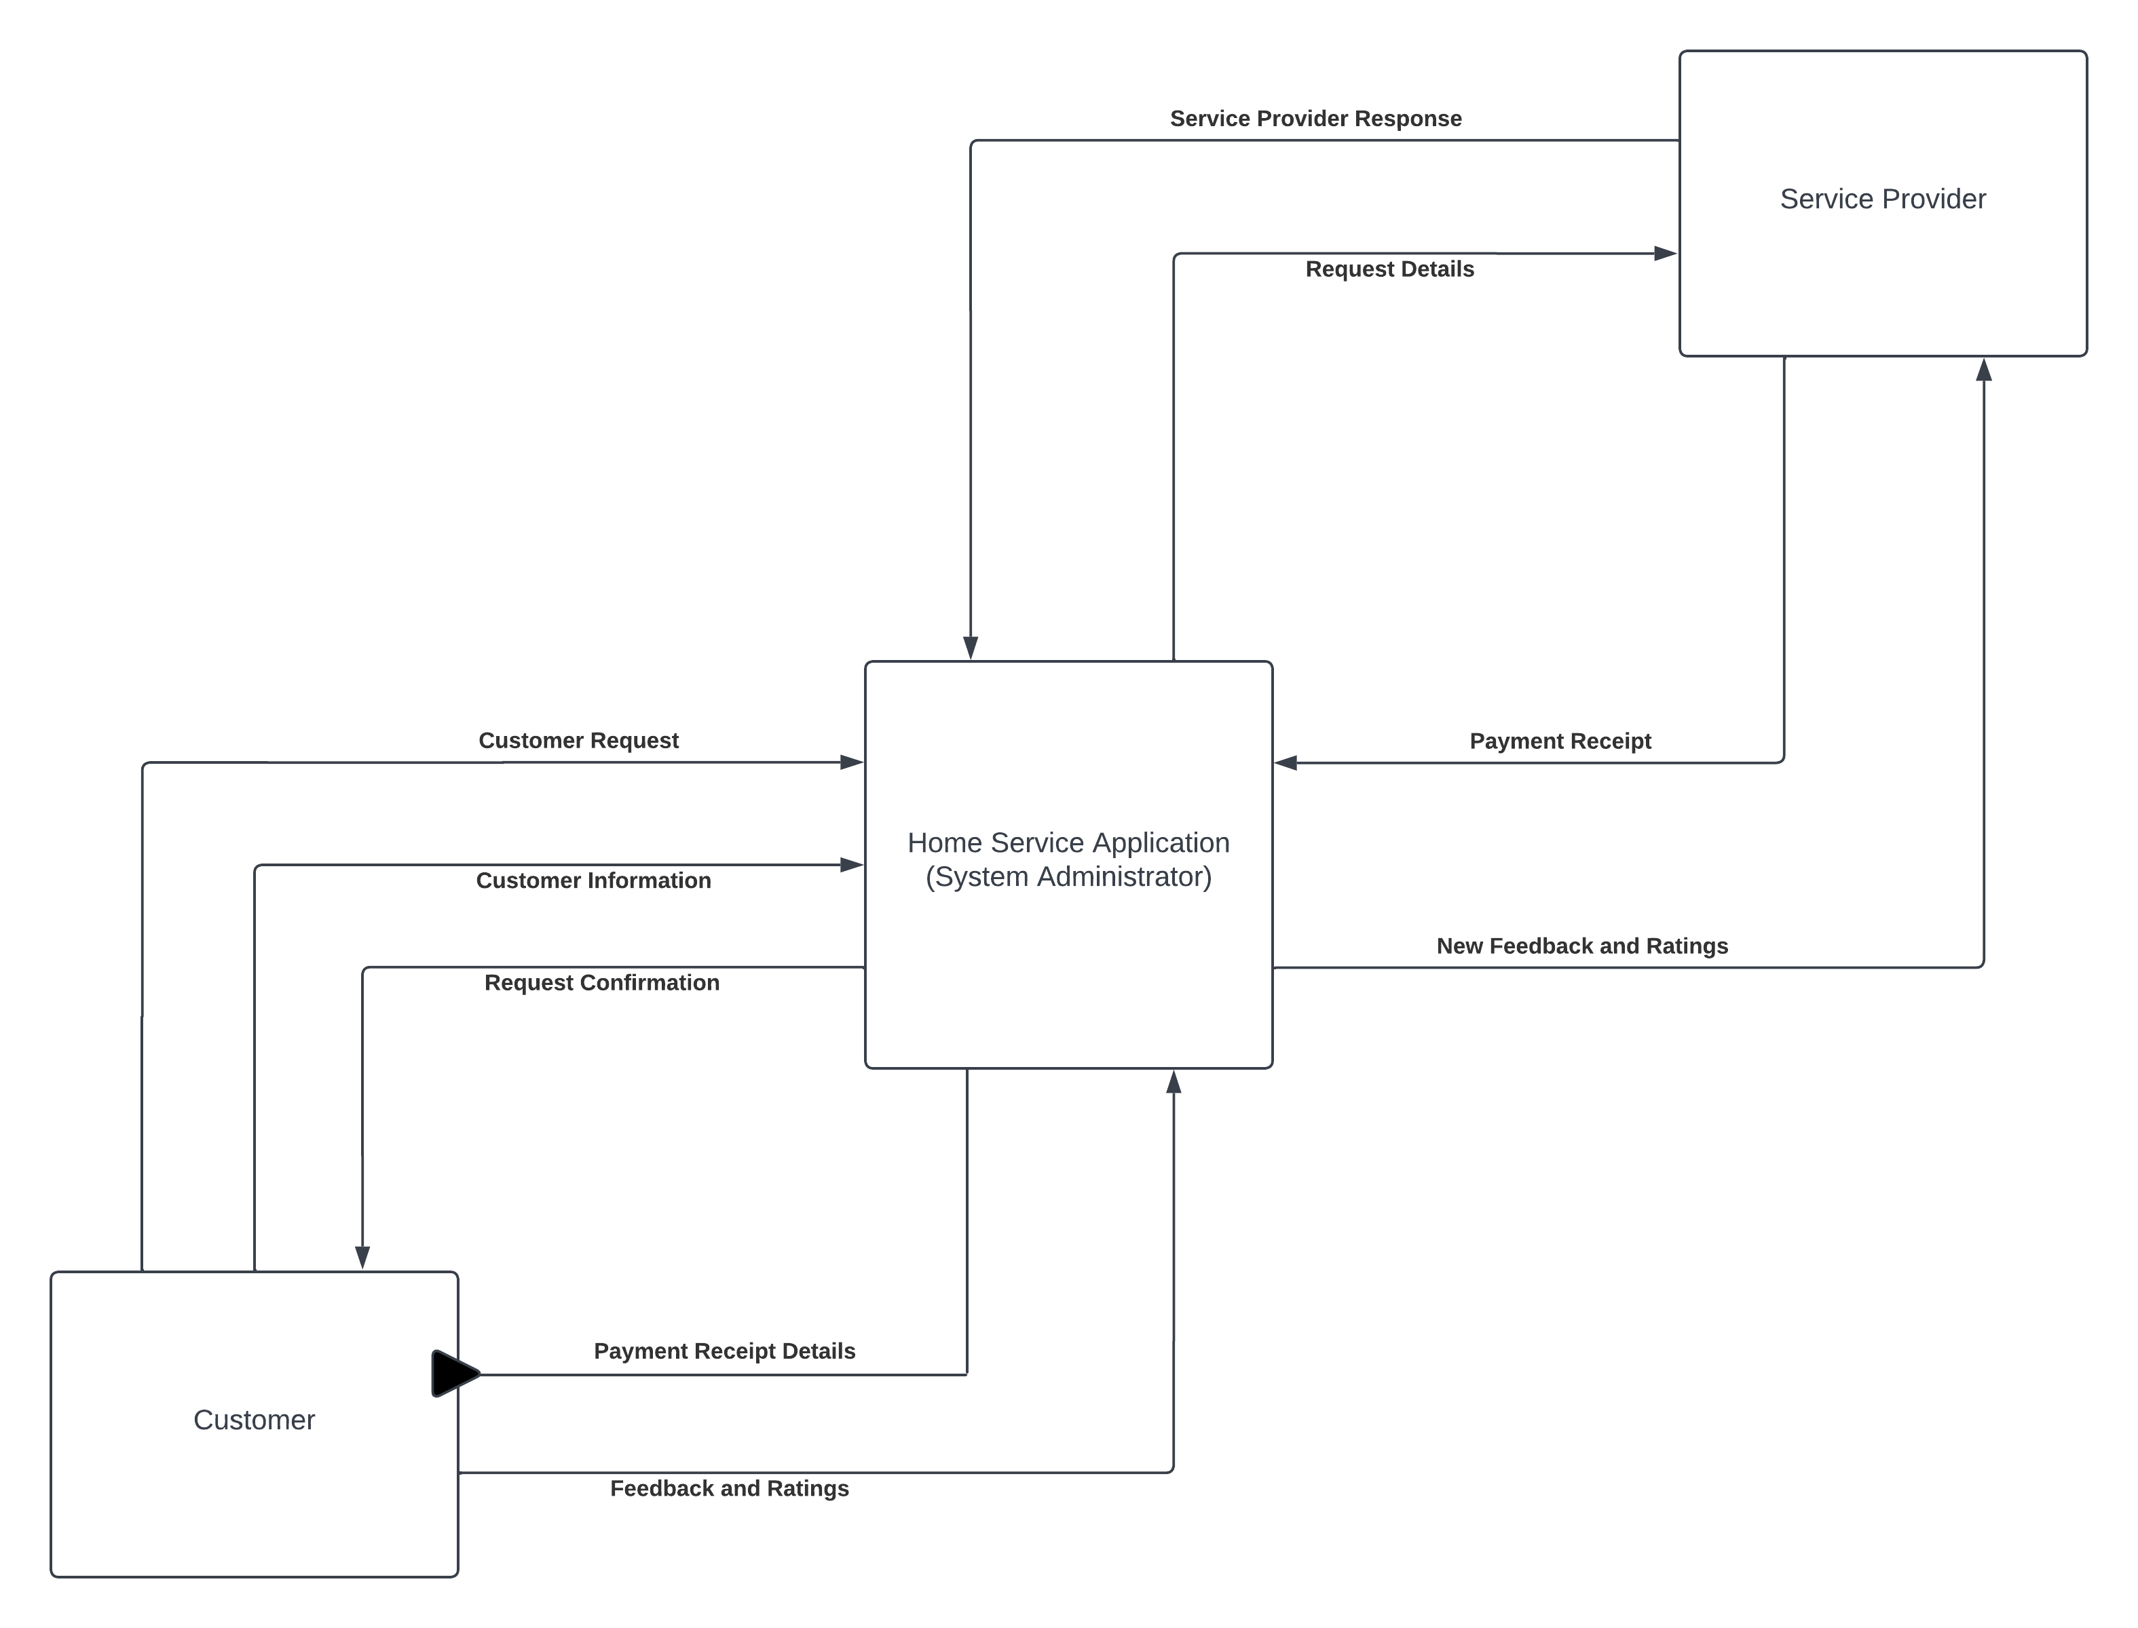
Data Flow Diagram Level 0

Slide 23
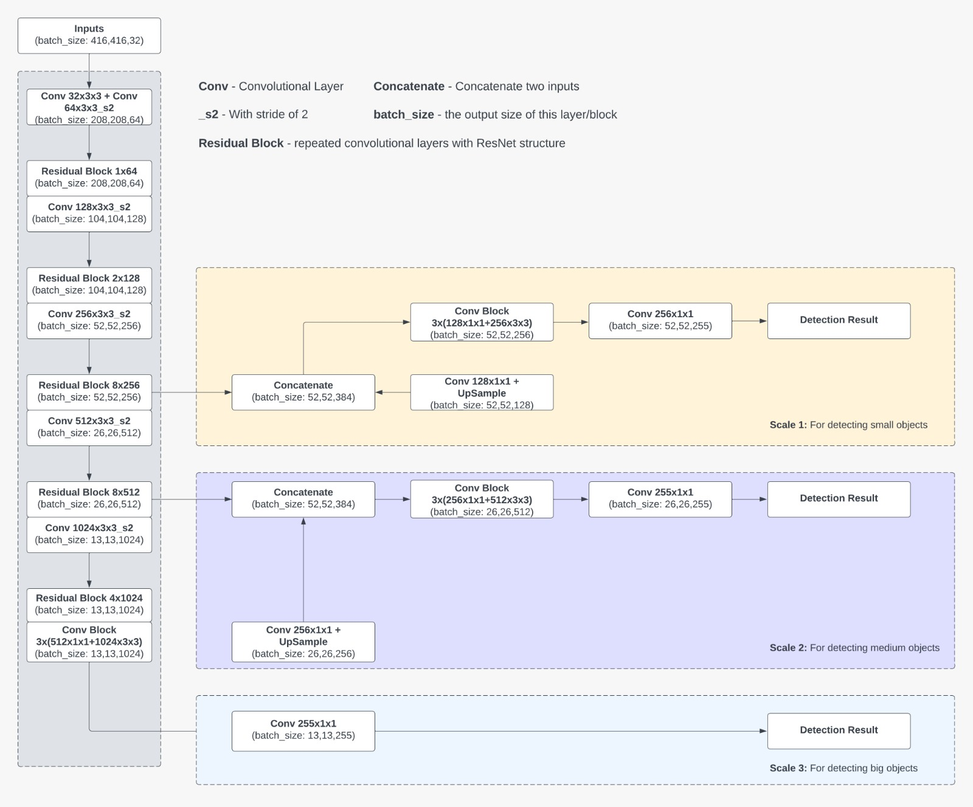
Algorithm Network Architecture

Slide 24


Sprint 6 Recap

Slide 25
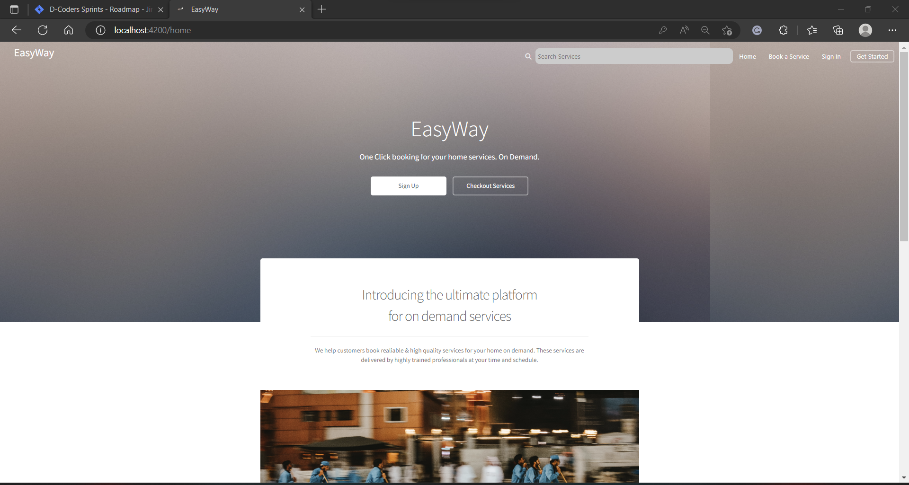
Search Bar

Slide 26
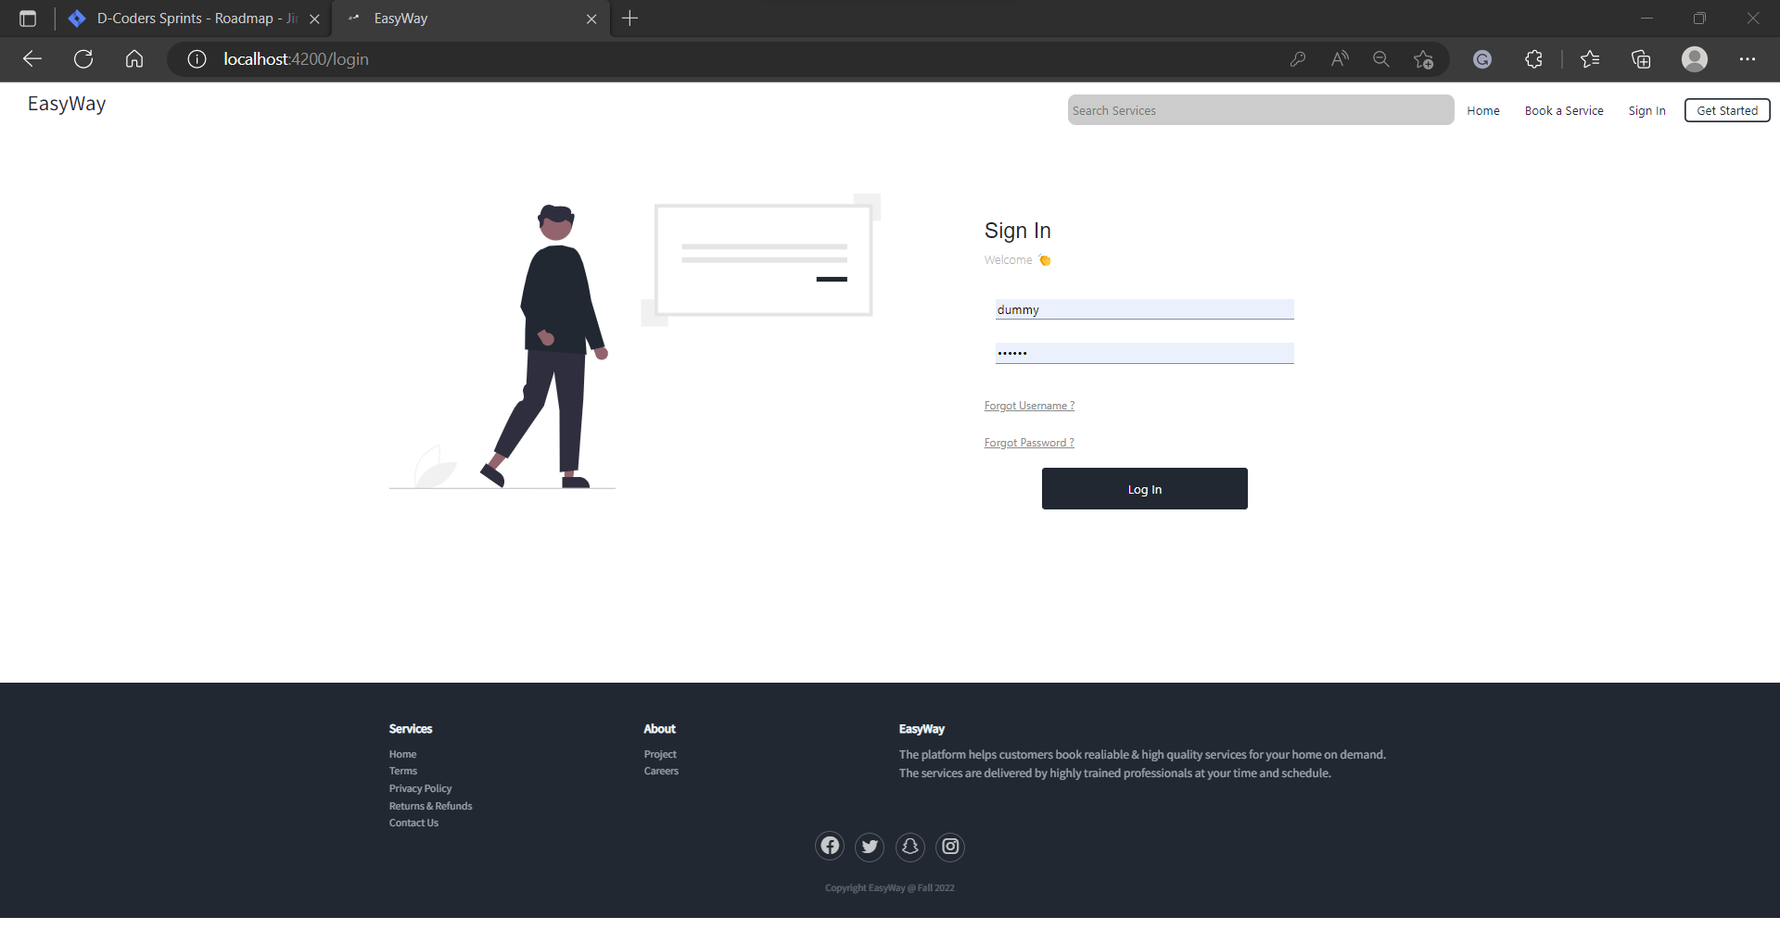
Login Screen

Slide 27
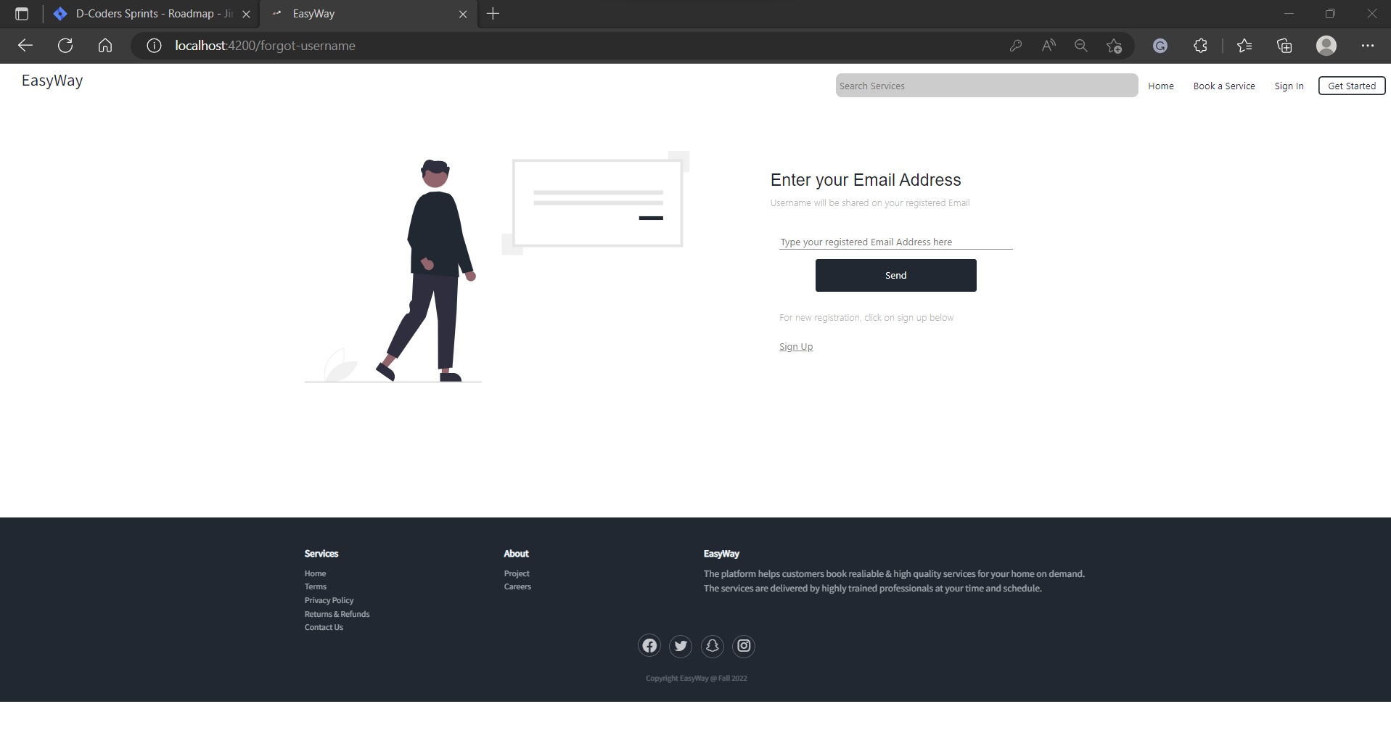
Forgot Username

Slide 28
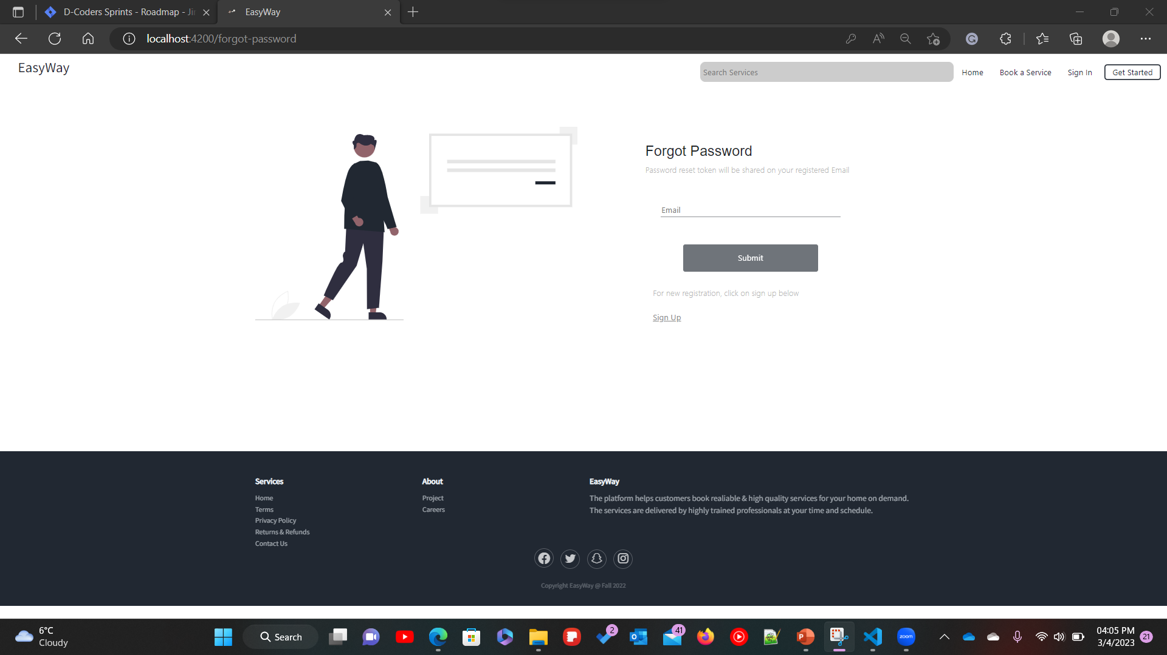
Forgot Password

Slide 29
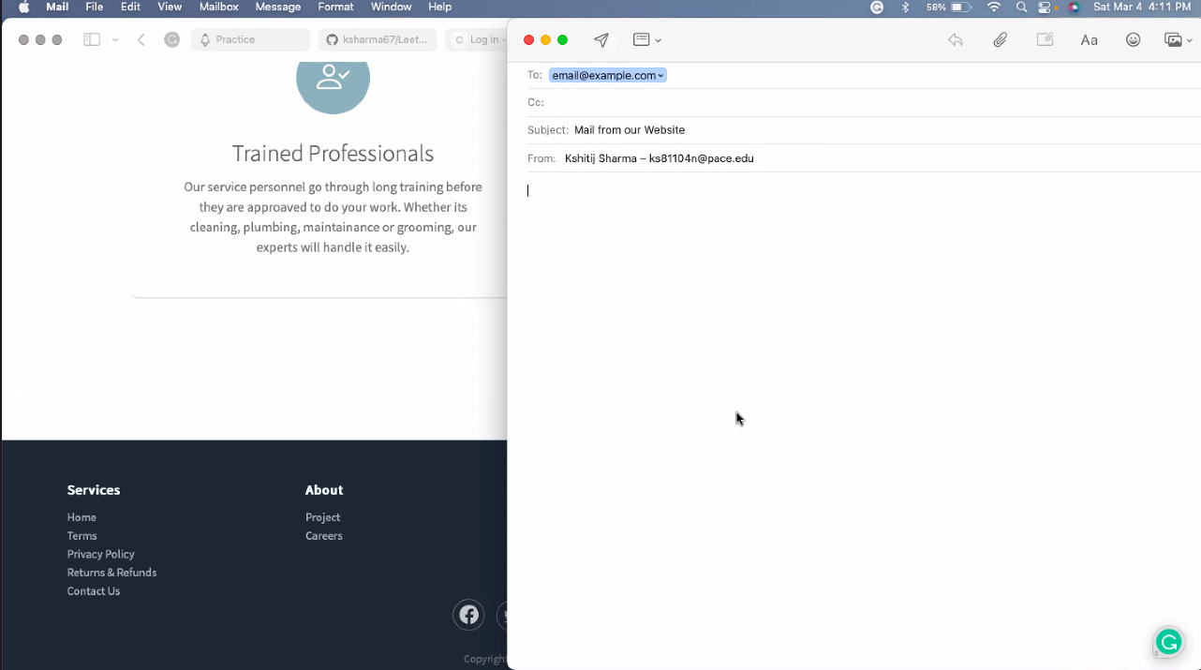
Email Customer Service

Slide 30
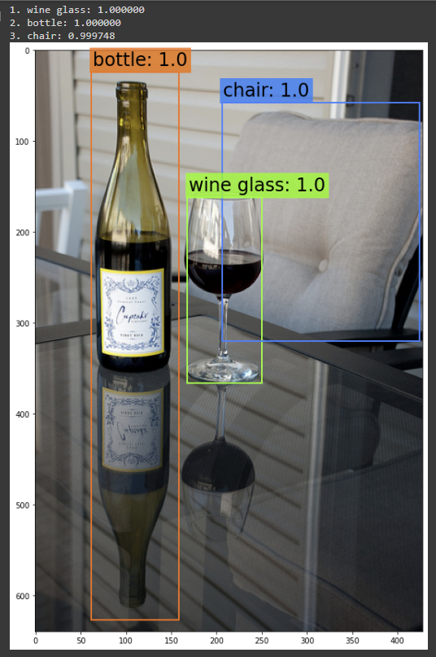
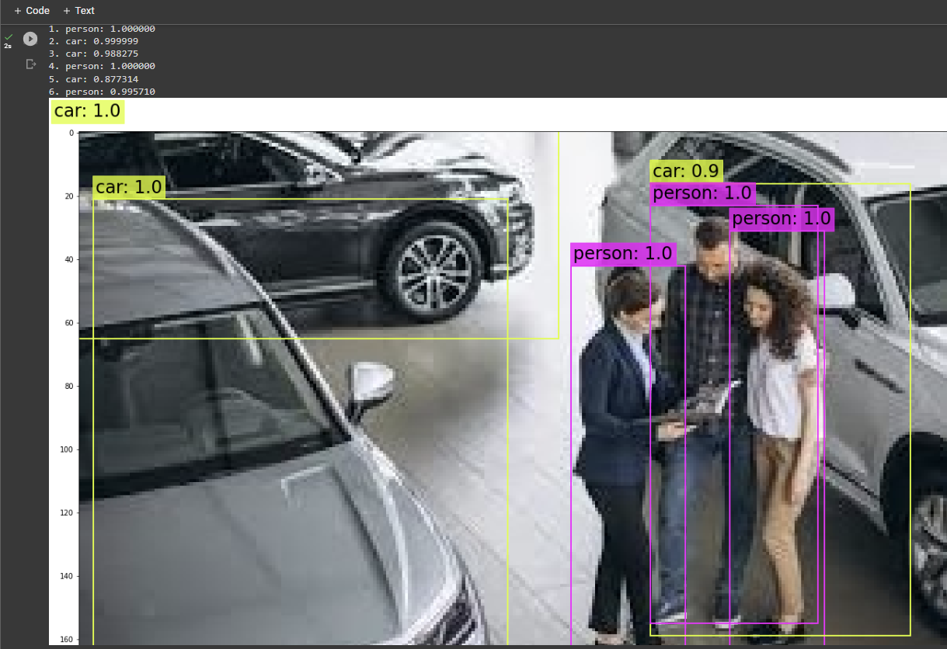
Object Detection Model

Slide 31
Sprint 6 Vs Sprint 7
Sprint 6
Sprint 7
Forgot Username.
Forgot Password.
Search Bar.
Email Customer Service.
See Blog post.
Upload a picture so that it can be redirected to the relevant service page.
Order / Service history page.
Directly Contact the technician via call/text.
Add multiple addresses.

Slide 32
Product Backlog
Issue Type | Key | Name
Task | DCS-74 | Updating API Documentation
Task | DCS-73 | Smoke Testing
Task | DCS-72 | Integration Testing
Task | DCS-71 | Improving Back End and Adding comments in the code base
Task | DCS-70 | Improving Front End
Story | DCS-32 | As a signed-in customer I want to be able to comment on a blog post So that I can get feedback on issues

Slide 33
Product Backlog
Issue Type | Key | Name
Story | DCS-39 | As a customer I want to be access the services according to categories such as water, furniture, beauty, etc So that I will be able to access the see the services available and who the professionals are.
Story | DCS-37 | As a customer, I want to be able to prepone or postpone my booked service So that I can expect the professional on some other date or time.
Story | DCS-33 | As a customer, I want to browse the service list So that I can get some information what does this particular service do.
Story | DCS-45 | As a customer I want to browse all the professional home services provided. So that I have a list to select the service I want.
Story | DCS-41 | As a customer I want to able to submit feedback So that the website owners can consider my opinion or concern during future website updates.
Story | DCS-40 | As a customer, I want to be able to access quick services near me So that I will be able to book an urgent situation at my house.

Slide 34
Sprint 7 Backlog
Issue Type | Key | Name | Story Points Estimate
Story | DCS-69 | As a signed-in customer I want to be able to see blog post So that I can get more information about the services, and website/app. | 5
Story | DCS-68 | As a customer I want to be able to upload a picture So that I can be redirected or suggested to the relevant service page in the app. | 8
Story | DCS-67 | As a customer I want to access my order/service history So that I can find all the details(date, charges, technician) of my past services in one place. | 5
Story | DCS-38 | As a customer I want to be able to directly contact the technician via call/text So that I can have a better service | 3
Story | DCS-35 | As a customer, I want to be able to add multiple address So that I can use them to schedule a service for my office. | 3

Slide 35
Stories and Acceptance criteria
User Stories And Acceptance Criteria
User Story ID | Summary
DCS-69 | As a customer I want to able to see blog post So that I can get more information about the services provided by the app
 | Scenario: Customer wants to view a blog post “Given I’m in a role of customer When I open the page with a specific blog post Then the system shows the “Blog” section
DCS-68 | As a customer I want to be able to upload a picture So that I can be redirected or suggested to the relevant service page in the app.
 | Scenario: Customer takes a picture of the object required for service “Given I’m in the role of customer When I open the page with a Lens Icon Then the system shows me to upload a picture And the system shows the relevant services according to the object.
DCS-38 | As a customer I want to be able to directly contact the technician via call/text So that I can have a better service
 | Scenario: Customer wants to contact a technician via call/text “Given I’m in the role of signed-in customer When I open the booked services Then the system shows the professional that got booked with their contact number
DCS-67 | As a signed-in customer I want to access my order/service history So that I can find all the details(date, charges, technician) of my past services in one place.
 | Scenario: Signed-in customer wants to see their booking history “Given I’m in the role of signed-in customer When I open Bookings in my profile Then the system shows the whole history of my bookings.
DCS-35 | As a signed-in customer I want to access my order/service history So that I can find all the details(date, charges, technician) of my past services in one place.
 | Scenario: Signed-in customer wants to see their booking history “Given I’m in the role of signed-in customer When I open Bookings in my profile Then the system shows the whole history of my bookings.

Slide 36
Test Cases
User Story ID | Unit to test | Assumptions | Test data | Steps to be executed | Expected Results
DCS - 12 | Login | Login should be successful | Email - test@easyway.com, Password - test123 | Homepage -> Login | Check results on entering valid User Id & Password
DCS - 12 | Login | It should show an error as "Invalid Username or Password" | Email - test@easyway.com, Password - test | Homepage -> Login | Check results on entering Invalid User ID & Password
DCS - 12 | Login | It should show an error as "Invalid Username or Password" | Email - easy@easyway.com, Password - test | Homepage -> Login | Check response when a User ID is Empty & Login Button is pressed
DCS - 13 | Sign Up | Sign Up should be successful | Email - any, Password - anything in between 8 to 16 char | Homepage -> Sign Up | Check results on entering valid User Id & Password
DCS - 13 | Sign Up | It should show an error as "Username already in use" | Email - test@easyway.com, Password - test123 | Homepage -> Sign Up | Check results on entering Already in Used User ID
DCS - 13 | Sign Up | It should show an error as "Enter the Password with given parameters" | Email - test@easyway.com, Password - test | Homepage -> Sign Up | Check response when a Password is containing all the given parameters
DCS - 49 | Profile | Profile creation should be successful | Email - test@easyway.com, Password - test | Homepage-> Login-> Profile | Check all the details filled with valid zip codes and phone numbers.
DCS - 49 | Profile | Show an error with missing fields | Email - , Password - test | Homepage-> Login-> Profile | Check to missing/mandatory fields*
DCS - 18 | Homepage | Services should be categorize and listed | localhost:4000/services | Homepage | Check if the categories are correct
DCS - 48 | Services | Display service catalog | db.getCollection("catalog").find({}); | MongoDB -> use Easyway
DCS - 51 | Professionals | Display list of professional | db.getCollection("professional").find({}); | MongoDB -> use Easyway
DCS - 49 | Customer | Insert a customer | db.customer.insert({name:"customerName",customerEmail:customer@test.com, customerPassword:12345678, customerPassword2:12345678}) | MongoDB -> use Easyway | Create a new user in customer database
DCS - 49 | Customer | Display all the customers | db.getCollection("customers").find({}); | MongoDB -> use Easyway
DCS - 18 | Homepage | Customers should be able to access the homepage | localhost:8080 | Homepage | Once directed with url, you will be first redirected to homepage.
DCS - 0 | Dummy Data | Display all collections | show collections | MongoDB -> use Easyway | All tables should be listed
DCS - 43 | Forgot password | Should direct to the email to reset the password |  | Homepage-> Login -> Forgot Password | Password Reset and directed to login page again
DCS - 61 | Customer Care | Should redirect to test@easyway.com with a subject | Clicking on Contact US | Homepage-> Footer -> Contact Us | Redirected to my email with mailto: test@easyway.com with a subject Test.
DCS - 62 | Forgot password | Should direct to the email to reset the password | Email - test@easyway.com, Token -> 1234 | Homepage-> Login -> Forgot Password | Not Authenticated
DCS - 62 | Forgot password | Should direct to the email to reset the password | Email - test1@easyway.com, Token -> The token that we got on email | Homepage-> Login -> Forgot Password | Email Not Found
DCS - 62 | Forgot password | Should direct to the email to reset the password | Email - test1@easyway.com, Token -> 1234 | Homepage-> Login -> Forgot Password | Email Not Found
DCS - 63 | Forgot username | Should direct to the email to send the username | Email - test@easyway.com | Homepage-> Login -> Forgot Username | Username sent on your email
DCS - 63 | Forgot username | Should direct to the email to send the username | Email - test1@easyway.com | Homepage-> Login -> Forgot Username | Email Not Found
DCS - 64 | Search | Should be able to search for services | AC | Homepage-> Search | AC service found
DCS - 64 | Search | Should be able to search for services | Z | Homepage-> Search | No Result

Slide 37
Test Cases
User Story ID | Unit to test | Assumptions | Test data | Steps to be executed | Expected Results
DCS - 24 | Homepage | Customer should be able to search the desired services on search box |  | Homepage-> Search box | Homepage must provide the search box for user to search for desired services.
DCS | Chatbot | Customer can interact and receive a response. |  | Homepage-> Login-> Book an Appointment-> Chat | One the chat started both customers and professional can chat in it.
DCS | Chatbot | Customer should be able to book appointment just by interaction and chatting with the chatbot |  | Homepage-> Chatbot | Homepage must provide the chatbot to clear all queries
DCS | Homepage | History displayed in search field should be relevant to logged in user only |  | Homepage-> Search box | Search box on Homepage must display relevant information previously searched by the user.
DCS | Service Page | Services should have filter option based on reviews and time arrive |  | Homepage ->Services -> Filter | Check if the results after correctly filtered
DCS - 35 | Customer | Customer should be able to add multiple addresses. | XYZ ABC | Homepage -> Login -> Profile ->Address | Must see multiple addresses on the address page of the customer.
DCS - 35 | Customer | Customer should be able to add multiple addresses. |  | Homepage -> Login -> Profile ->Address | Error

Slide 38
Stories \ Task Completed and Not Completed
Issue Type | Key | Name | Status
Story | DCS-69 | As a signed-in customer I want to be able to see blog post So that I can get more information about the services, and website/app. | Done
Story | DCS-68 | As a customer I want to be able to upload a picture So that I can be redirected or suggested to the relevant service page in the app. | Done
Story | DCS-67 | As a customer I want to access my order/service history So that I can find all the details(date, charges, technician) of my past services in one place. | Done
Story | DCS-38 | As a customer I want to be able to directly contact the technician via call/text So that I can have a better service | Done
Story | DCS-35 | As a customer, I want to be able to add multiple address So that I can use them to schedule a service for my office. | Done

Slide 39

Metrics

Slide 40

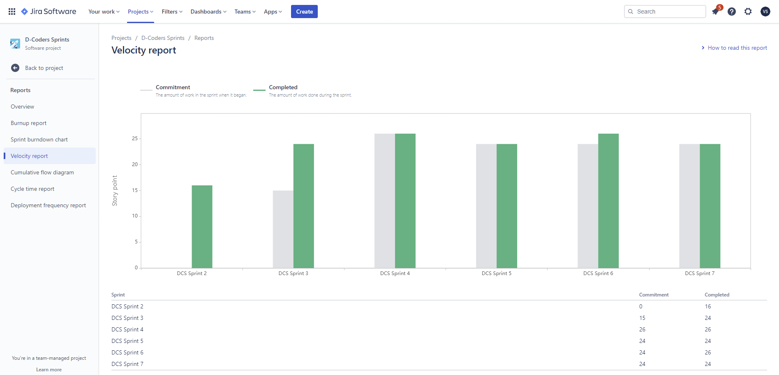
Team Velocity Chart

Slide 41
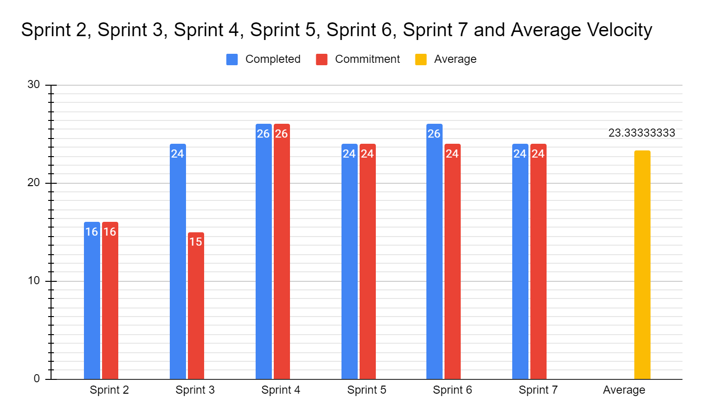
Team Historical Velocity (Average)

Slide 42
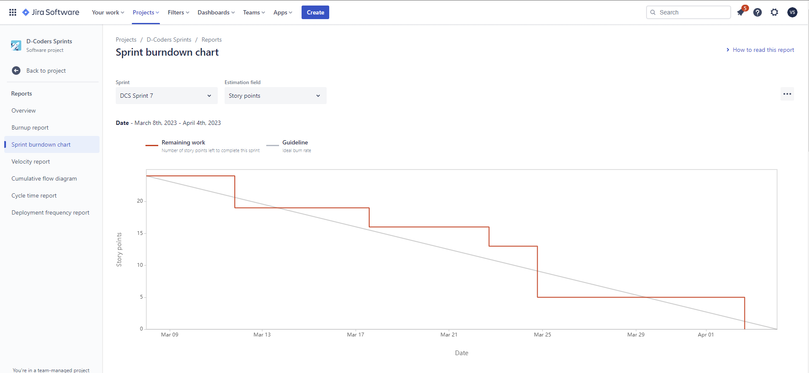
Burndown Charts

Slide 43
Completed / Committed Ratio

Slide 44

Retrospective

Slide 45

What Went Well
Tasks were clearly defined and assigned at the beginning of the sprint
The structure of pages was well-defined in the previous sprints, so it was easy to design inner pages with forms.
Teammates started to update their stories on Jira board.
Deadlines were made clear to each team member, and everyone adhered enthusiastically.
Sprint planning this time made it super clear what we needed to achieve and what a team member will be working on.

Slide 46
What Needs Improvement
Lately not conducting the calls which used to happen twice a week.
Some of the test cases were not passing the 100% parameter and their score was less than 90%.
Some of the set deadlines were not adhered to.

Slide 47
Next Steps
Conduct two weekly calls as before where updates are shared. Requesting the team to discuss their schedule so the meetings can be held.
Integration and smoke testing will be done thoroughly in the last deliverable.
Something like Daily Standups should be held so that teammates who need help can discuss it with others and get the work done. It will also help all of us to get ready for the tech companies.

Slide 48

Sprint 8

Slide 49
Stories planned and committed for Sprint 8
Issue Type | Key | Name | Status | Story Point Estimate
Task | DCS-74 | Updating API Documentation | To Do | 5
Task | DCS-73 | Smoke Testing | To Do | 4
Task | DCS-72 | Integration Testing | To Do | 2
Task | DCS-71 | Improving Back End and Adding comments in the code base | To Do | 4
Task | DCS-70 | Improving Front End | To Do | 4
Story | DCS-32 | As a signed-in customer I want to be able to comment on a blog post So that I can get feedback on issues | To Do | 4

Slide 50

Project Demo

Slide 51

Slide App Screenshot

Slide 52
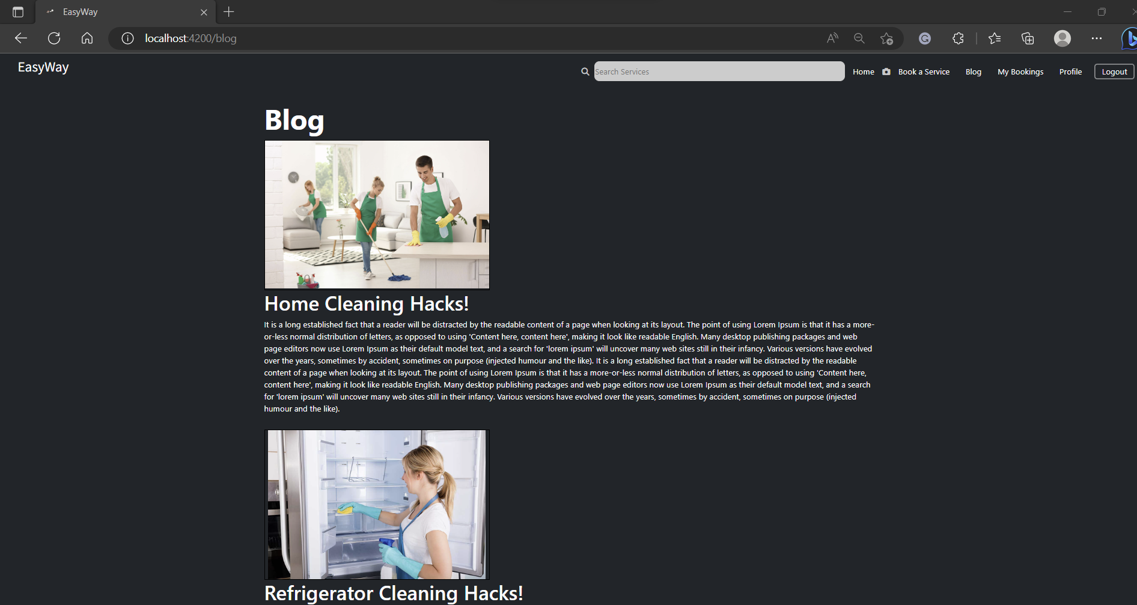
See Blog Post

Slide 53
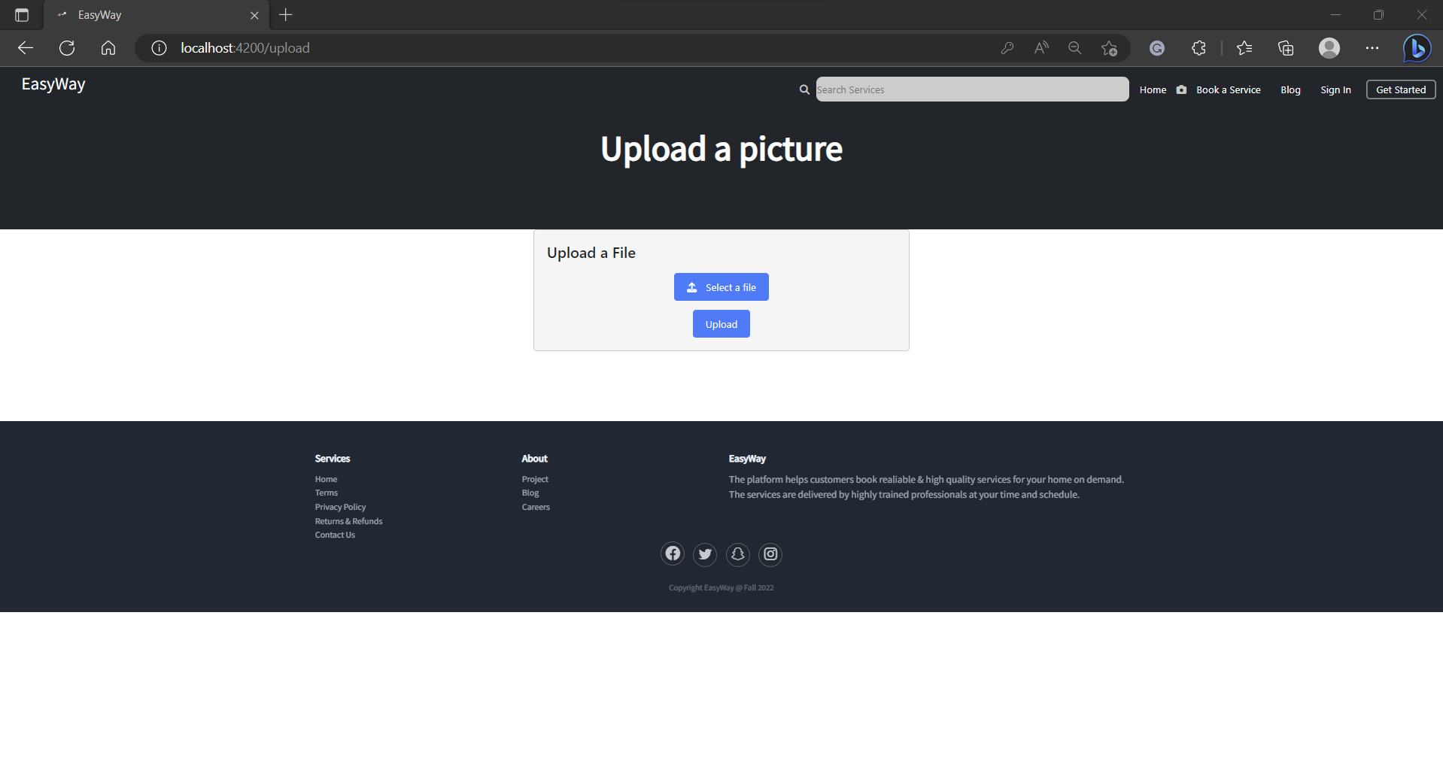
Upload Picture

Slide 54
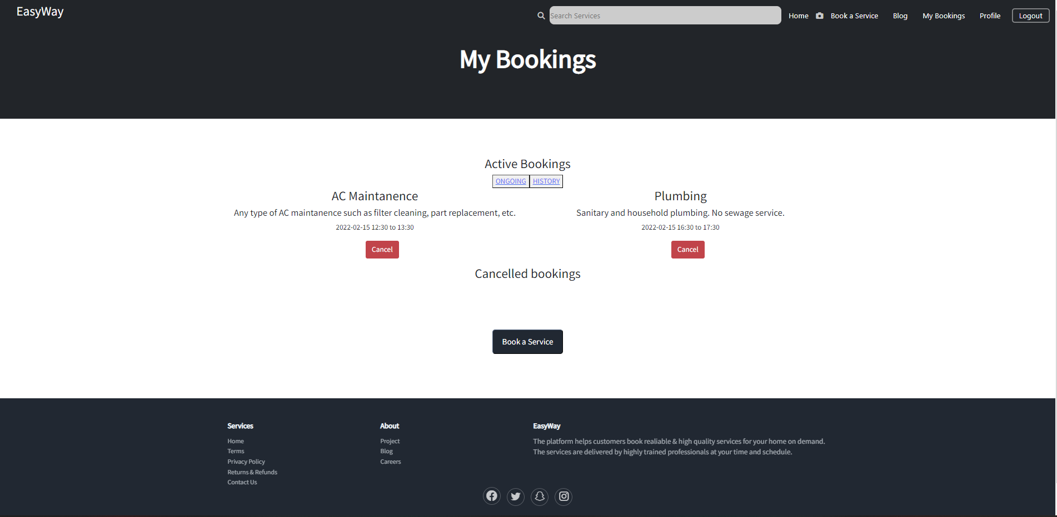
Order / Service History Page

Slide 55
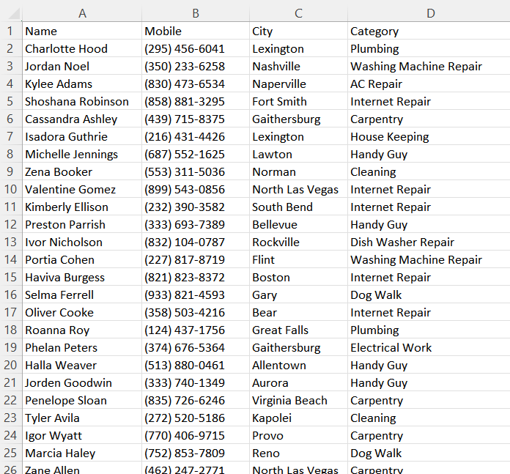
Directly Contact the Technician

Slide 56
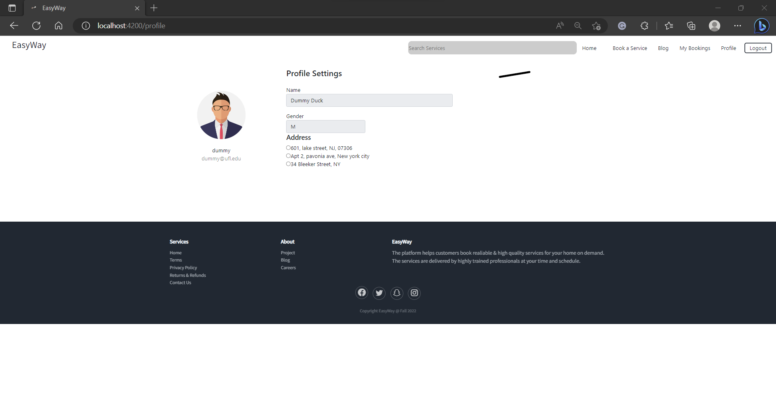
Multiple Addresses

Slide 57
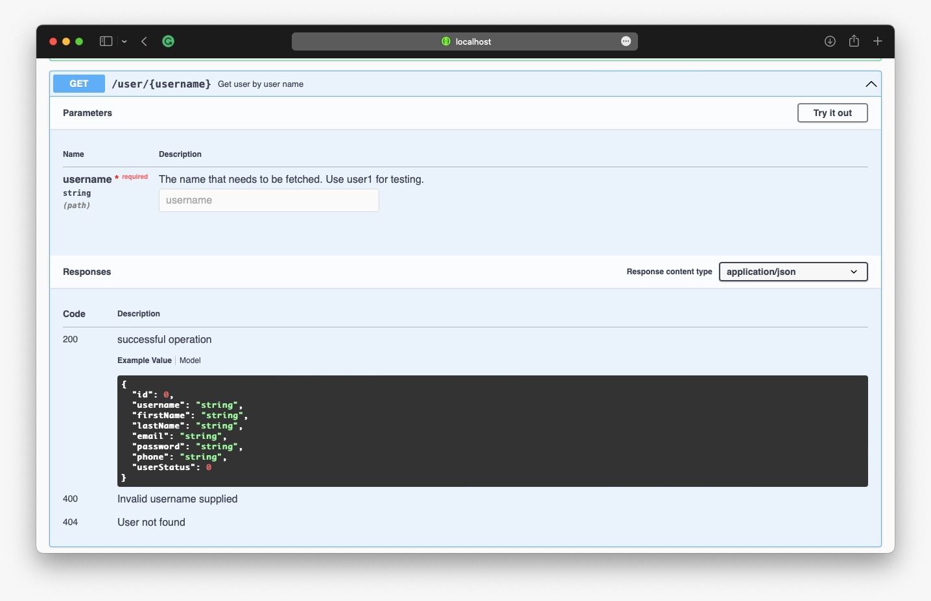
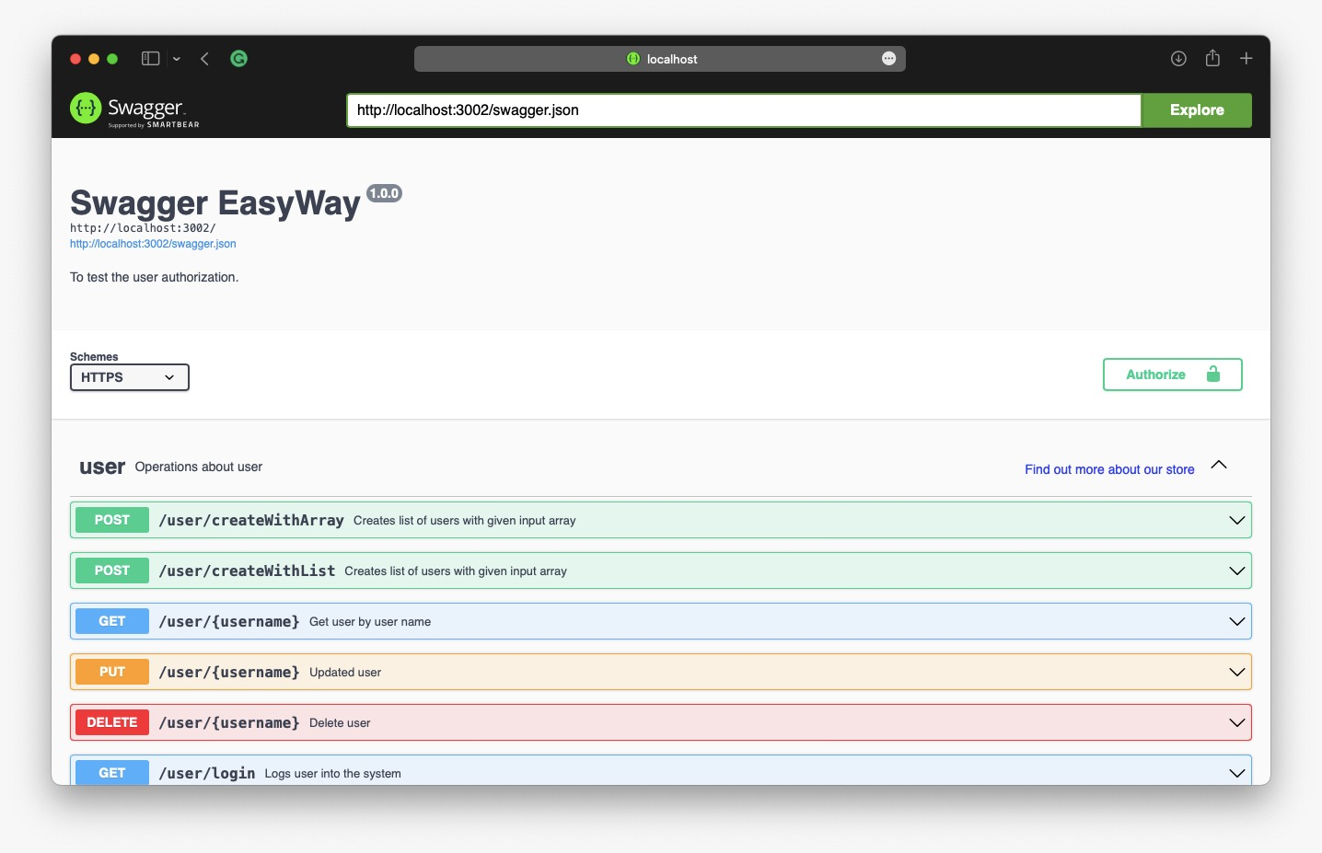
Slides for API

Slide 58
GitHub Link
Home · ksharma67/EasyWay Wiki (github.com)
Technical Paper Link
EASYWAY TECHNICAL PAPER (GITHUB.COM)
Deployment Manual Link
EasyWay Deployment Manual PDF
API Documentation
EasyWay/API Documentation.pdf at main · ksharma67/EasyWay (github.com)

Slide 59
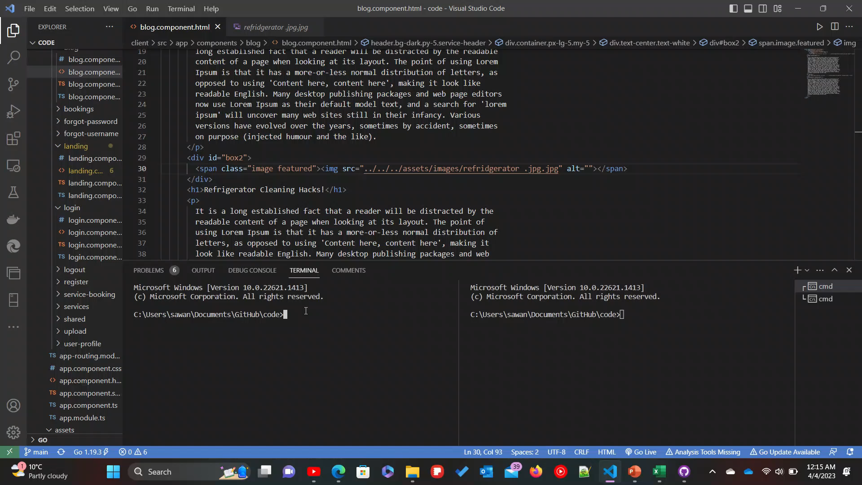
Live Application Demo

Slide 60

Thank You From D-Coders

